Slide 1
Blue zone
Loma Linda
by majda Nevařilová

Slide 2
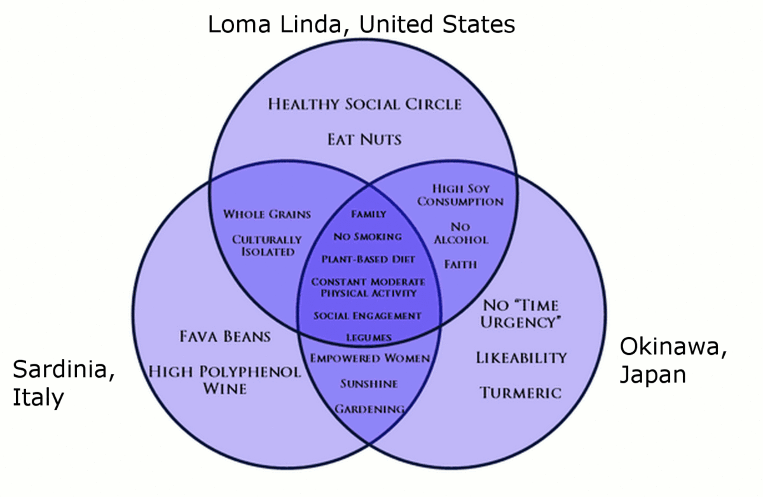
Blue zone - information
Blue zones are regions of the world where people live longer than usually.
There are 5 blue zones.
In the blue zones people follow a lifestyle thanks to which they live to a great age.
Blue zones are places where people live without health problems.

Slide 3
location

Slide 4
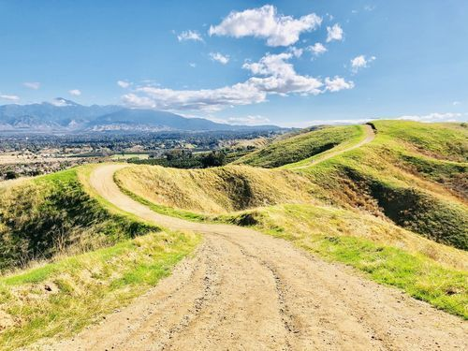
Loma Linda - California
Loma Linda is a town in California.
The place is known for one of the highest numbers of longevity in the United States.
There is no polluted air or polluted water.
It strictly controls the sale of alcohol and has banned
smoking in public.

Slide 5
longevity
Residents live 10 healthy years more than the an average American.
They follow a biblical diet of grains, fruits, nuts, and vegetables
Residents in Loma Linda do not smoke or drink alcohol. (someone does)
There is the Seventh-day Adventist Church.
Faith, social engagement, regular moderate
physical activity

Slide 6
food
They follow a plant based diet.
They eat health food, for example grains, nuts, vegetables, legumes…
People have a high soy consumption.
Residents Loma Linda do not suffer from obesity because they eat healthy food.
Adventists who consume nuts at least five times a week have about half the risk of heart disease and live about two years longer than those who don’t.
They eat meat in moderation.
Many people follow a vegetarian diet.

Slide 7
regular, moderate exercise
Getting regular, low-intensity exercise like daily walks seems to help reduce your chance of having a heart disease and certain types of cancer.
Adventists who stay active and eat meat sparingly, if at all, have lower blood pressure, lower blood cholesterol, and fewer cardiovascular disease than heavier Americans.

Slide 8
Thank you for your attention

