Slide 1

Photo Album 4
Europe in S.H.A.P.E.
PREVENTION

Slide 2
It is often said that prevention is better than cure. That is why we couldn´t avoid this topic in our project. The letter P in S.H.A.P.E. stands for Prevention.
We believe that through prevention we can stop or at least discourage children from leading unhealthy life, being obese, becoming addict, etc.
Project activities aimed at prevention included:
- The Blue Zones Project – Children explored what Blue Zones are about, they found out what was making them such great places to live. They created a plan with ideas what they could do to lead happier and healthier life. They made a commitment to implement some changes in their lives and then they evaluated their work.
- Don´t Waste Your Waste – Pupils learned about possibilities to recycle waste in their area, planned and organized a recycling event and evaluated it.
- The Nutritional Therapy Programme – an educative programme about the importance of balanced diet, healthy eating habits, etc.
- Also during our project meetings we participated in a lot of preventive activities including hippotherapy, aromatherapy, music therapy, etc.

Slide 3
Have a look at the photos and enjoy!

Slide 4
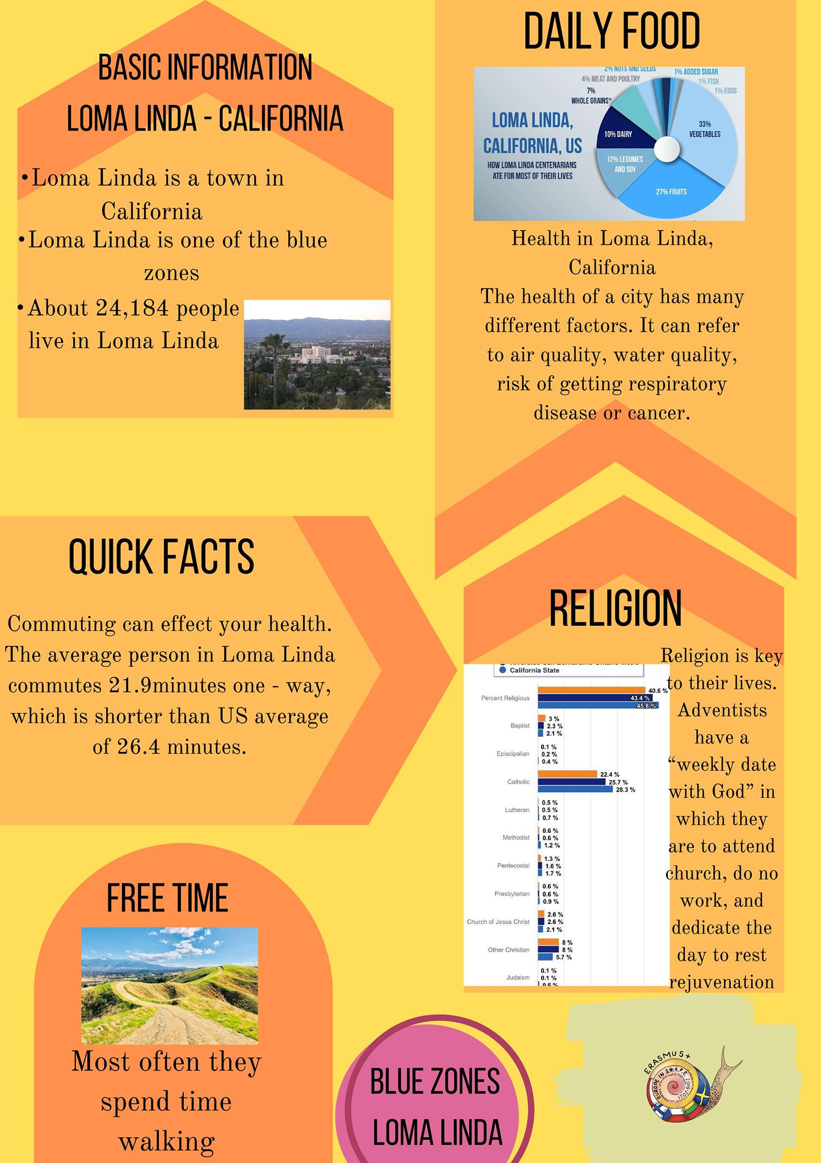
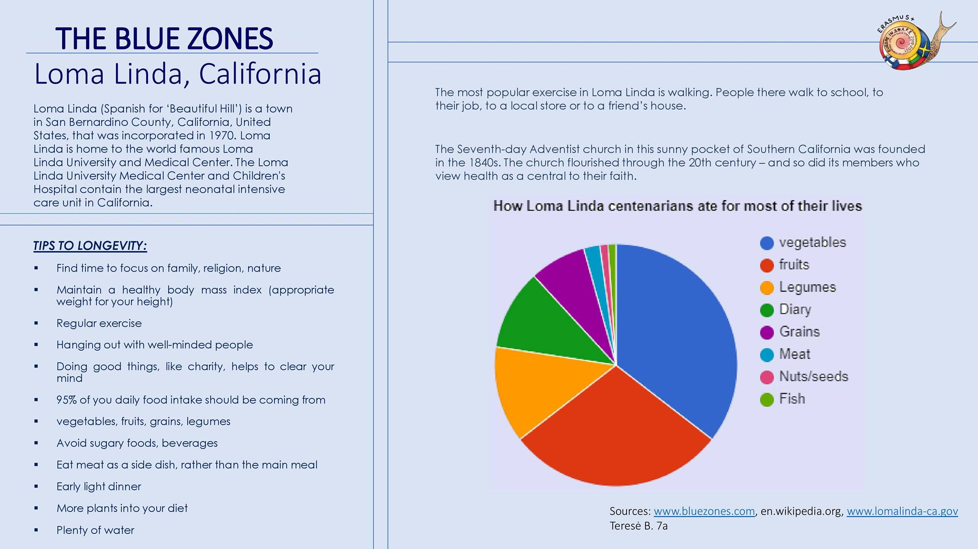

Slide 5
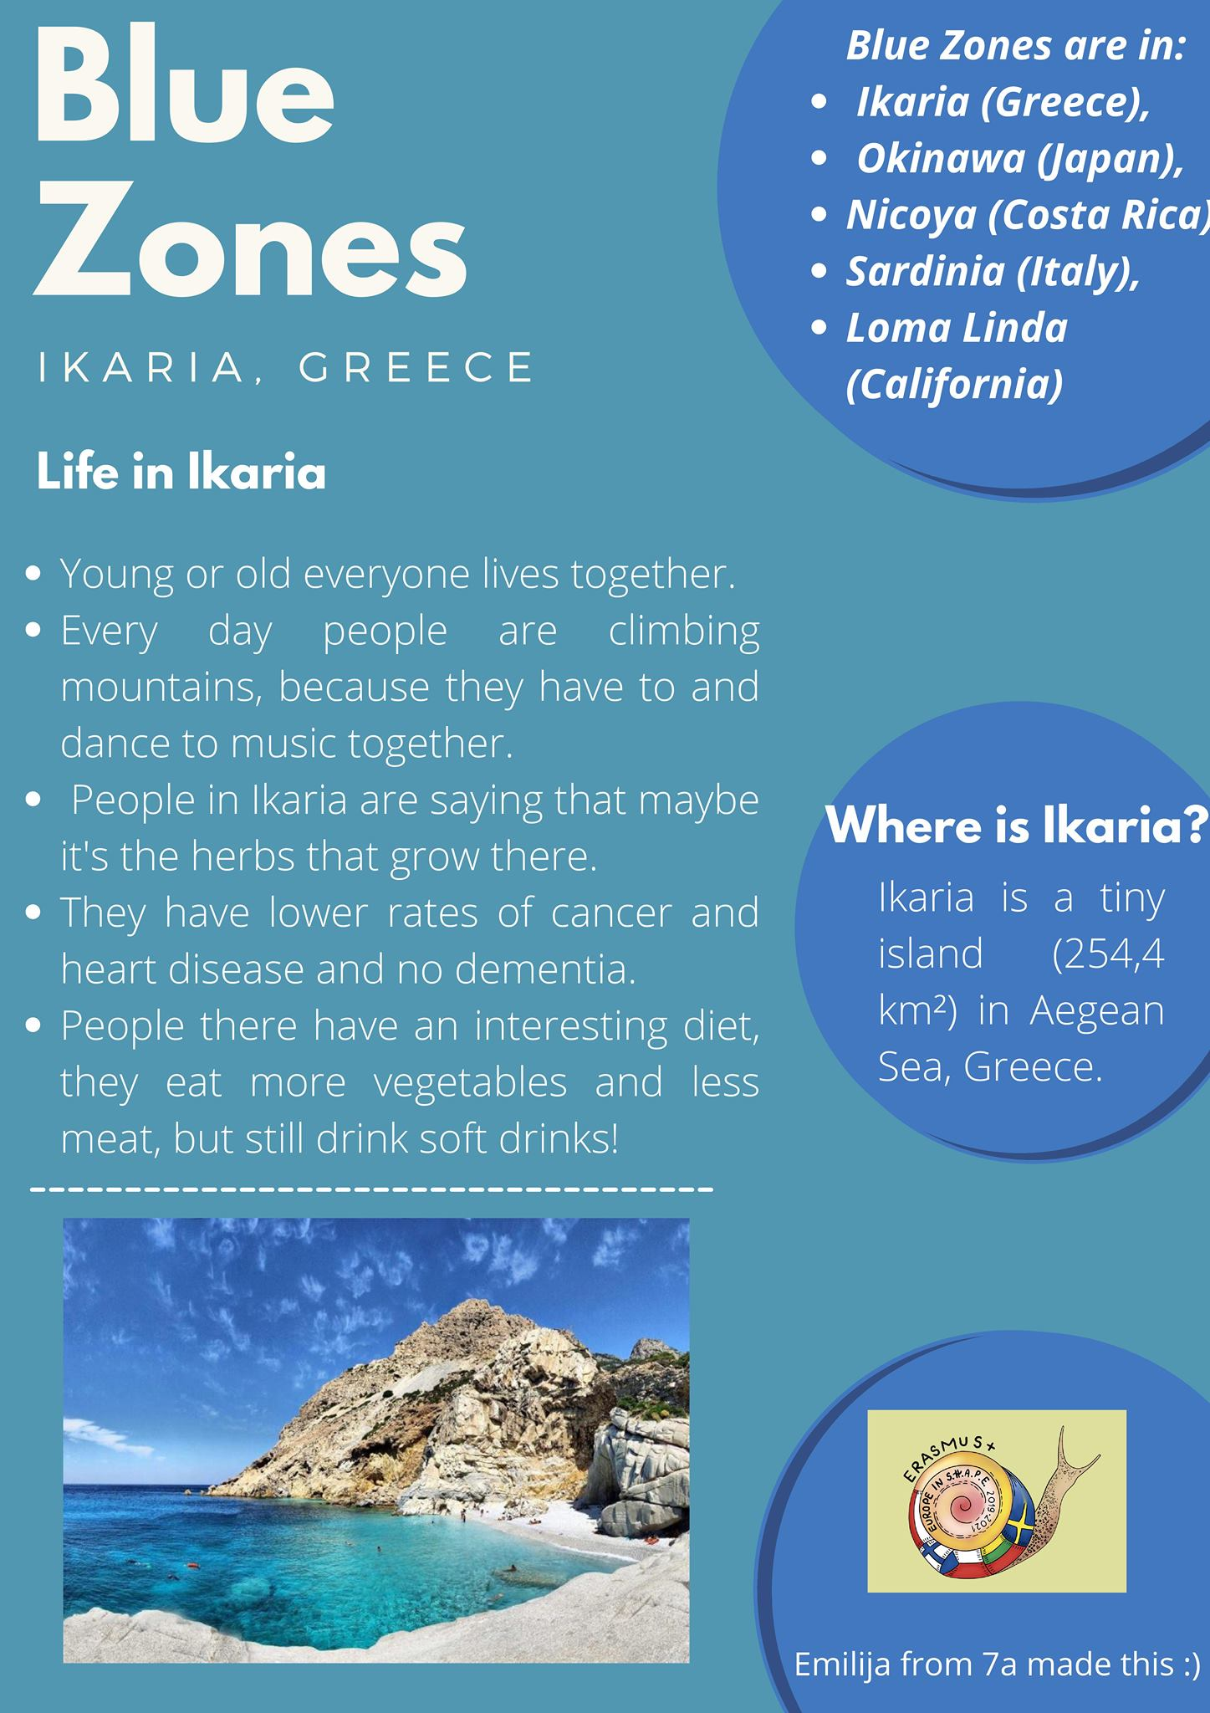
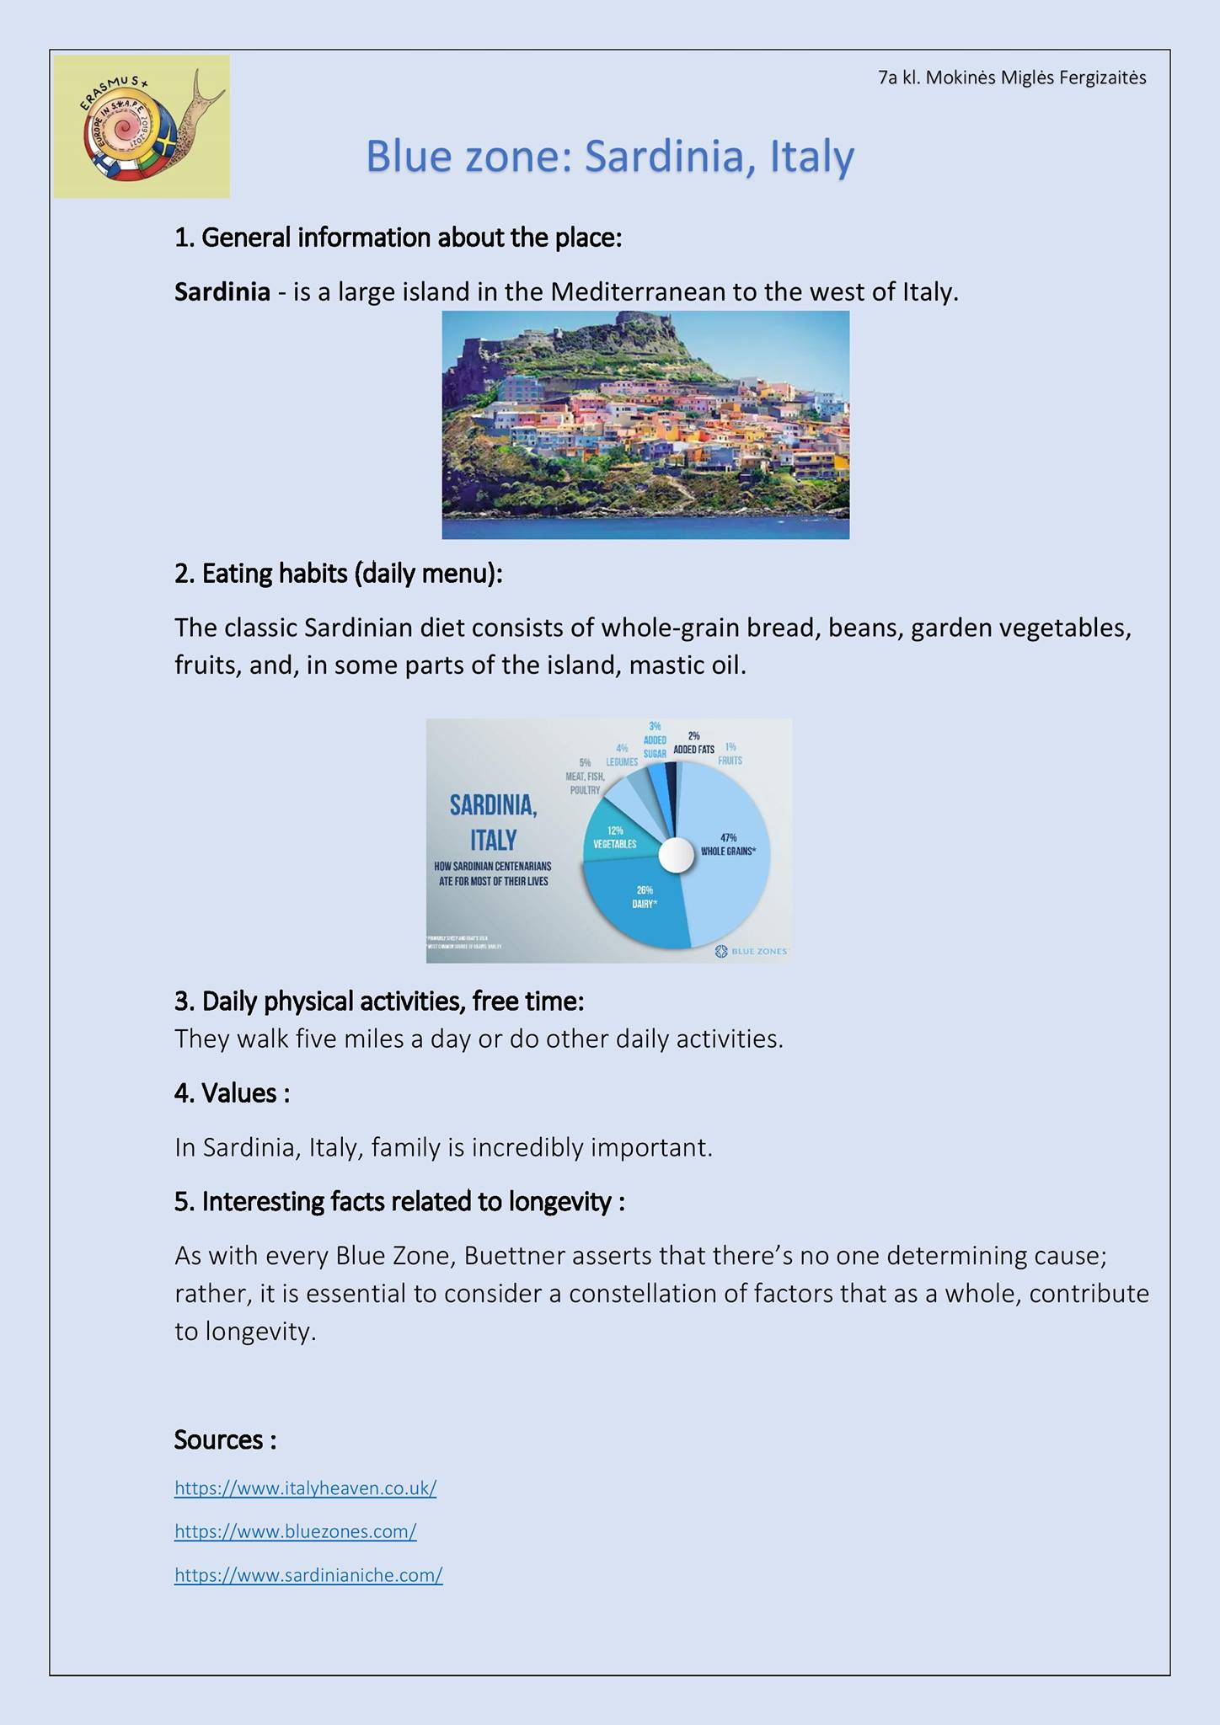

Slide 6
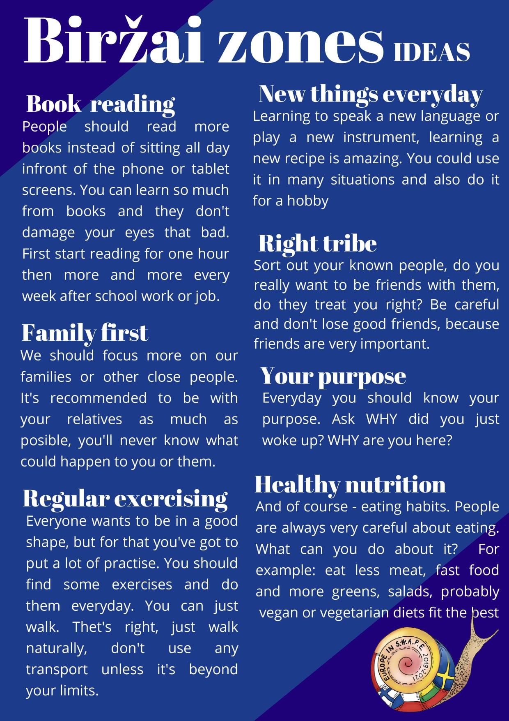
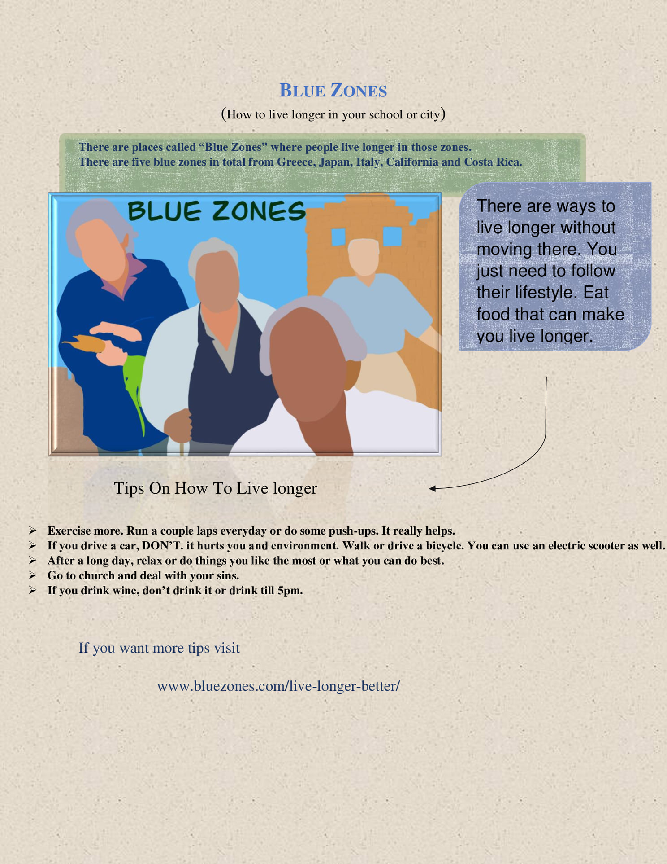

Slide 7

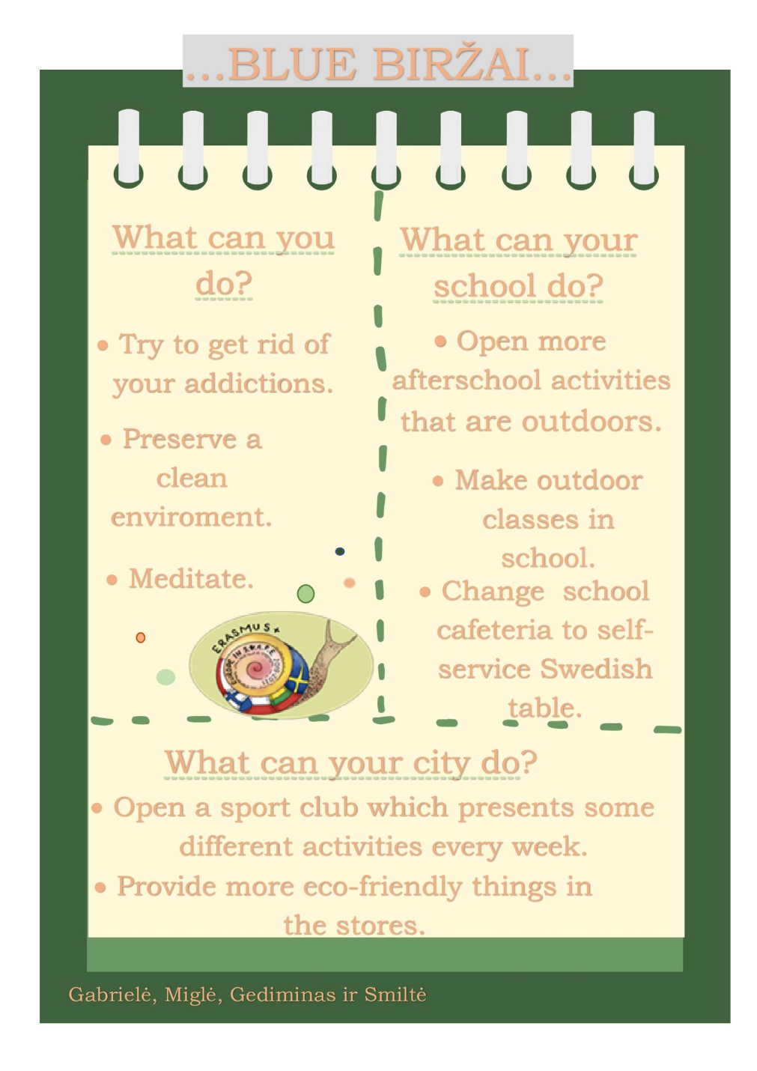

Slide 8
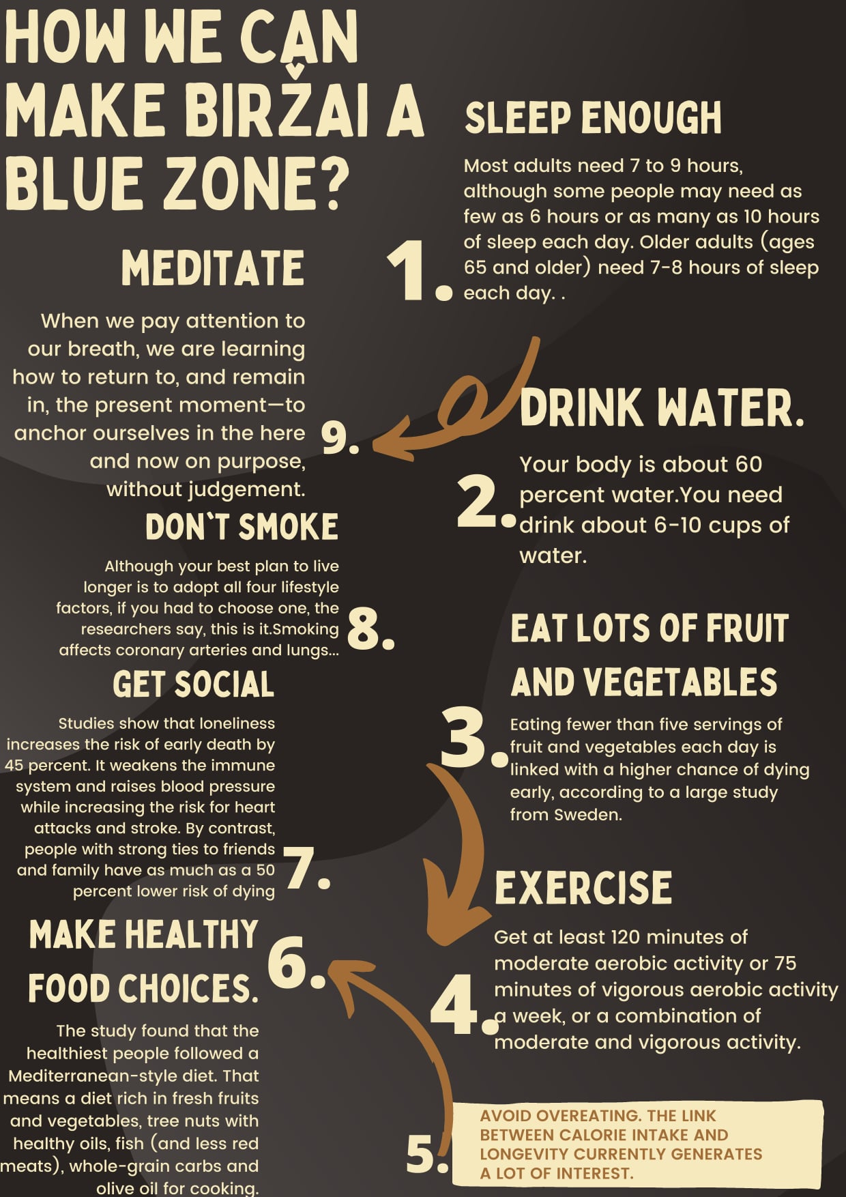
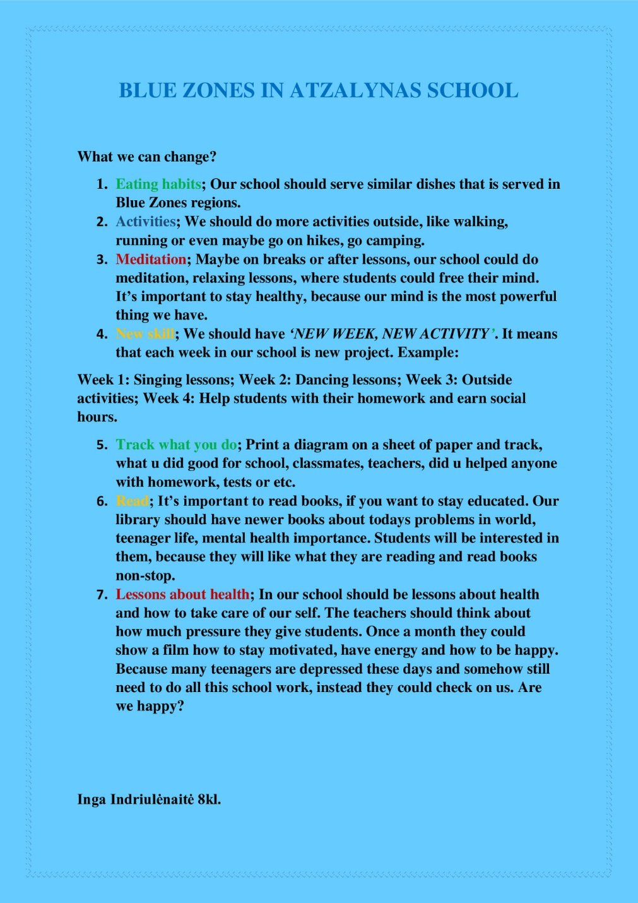

Slide 9
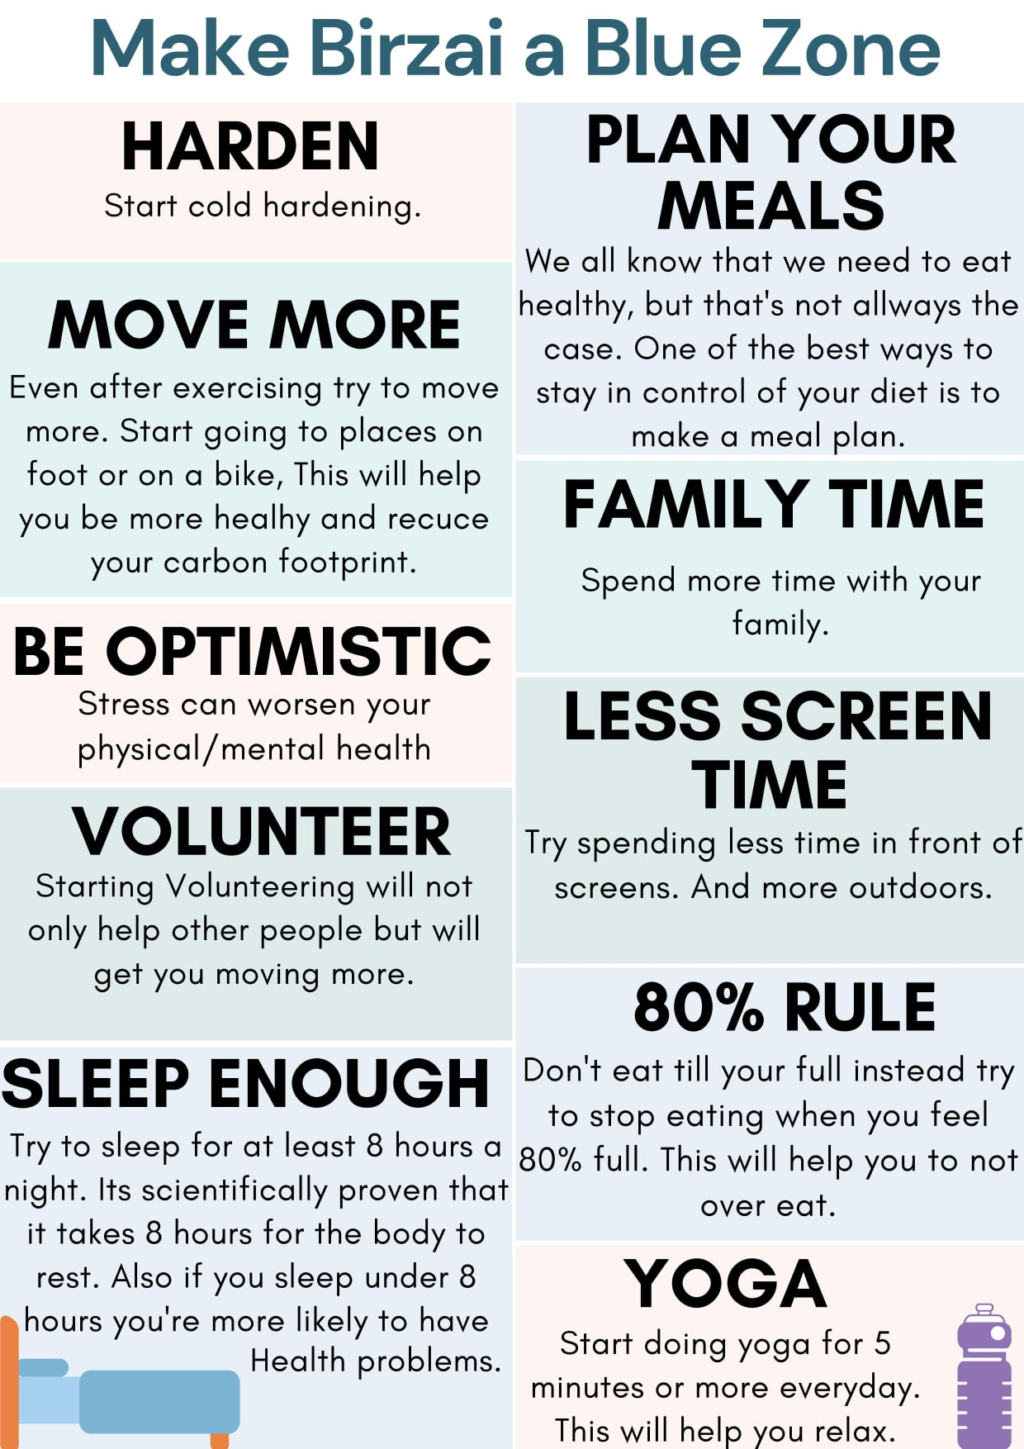


Slide 10
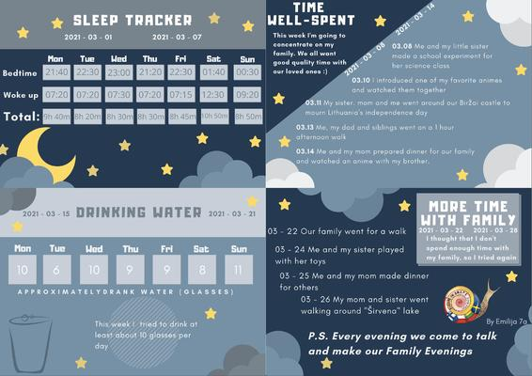
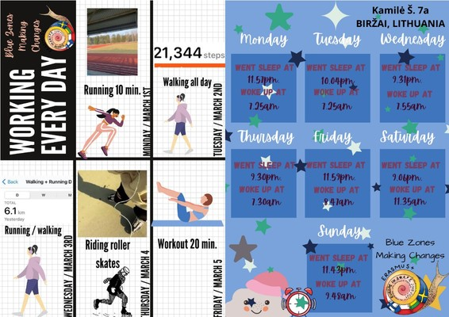

Slide 11
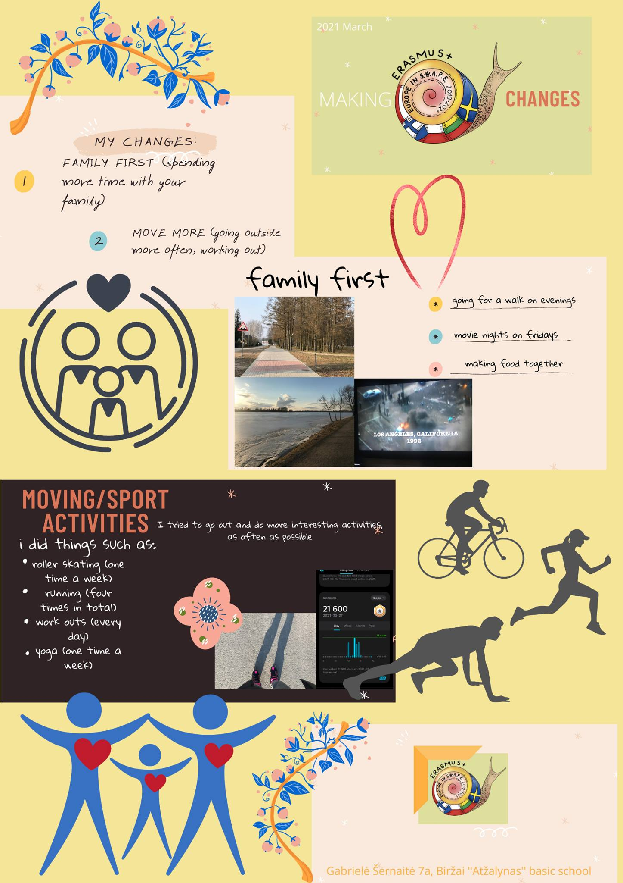


Slide 12
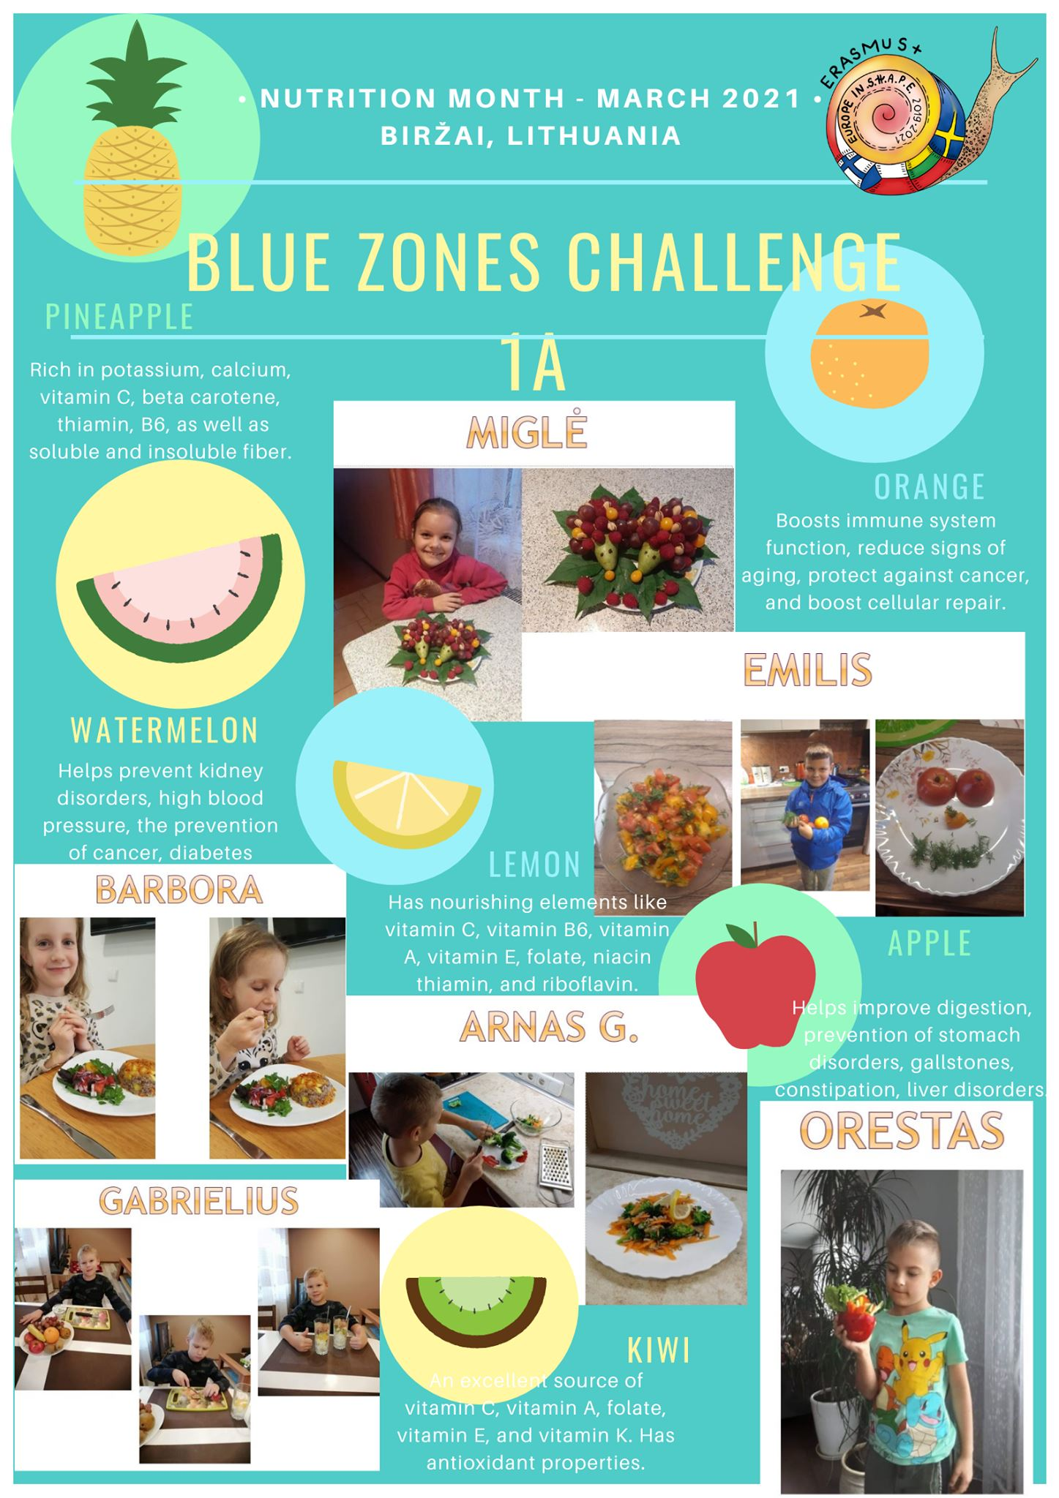
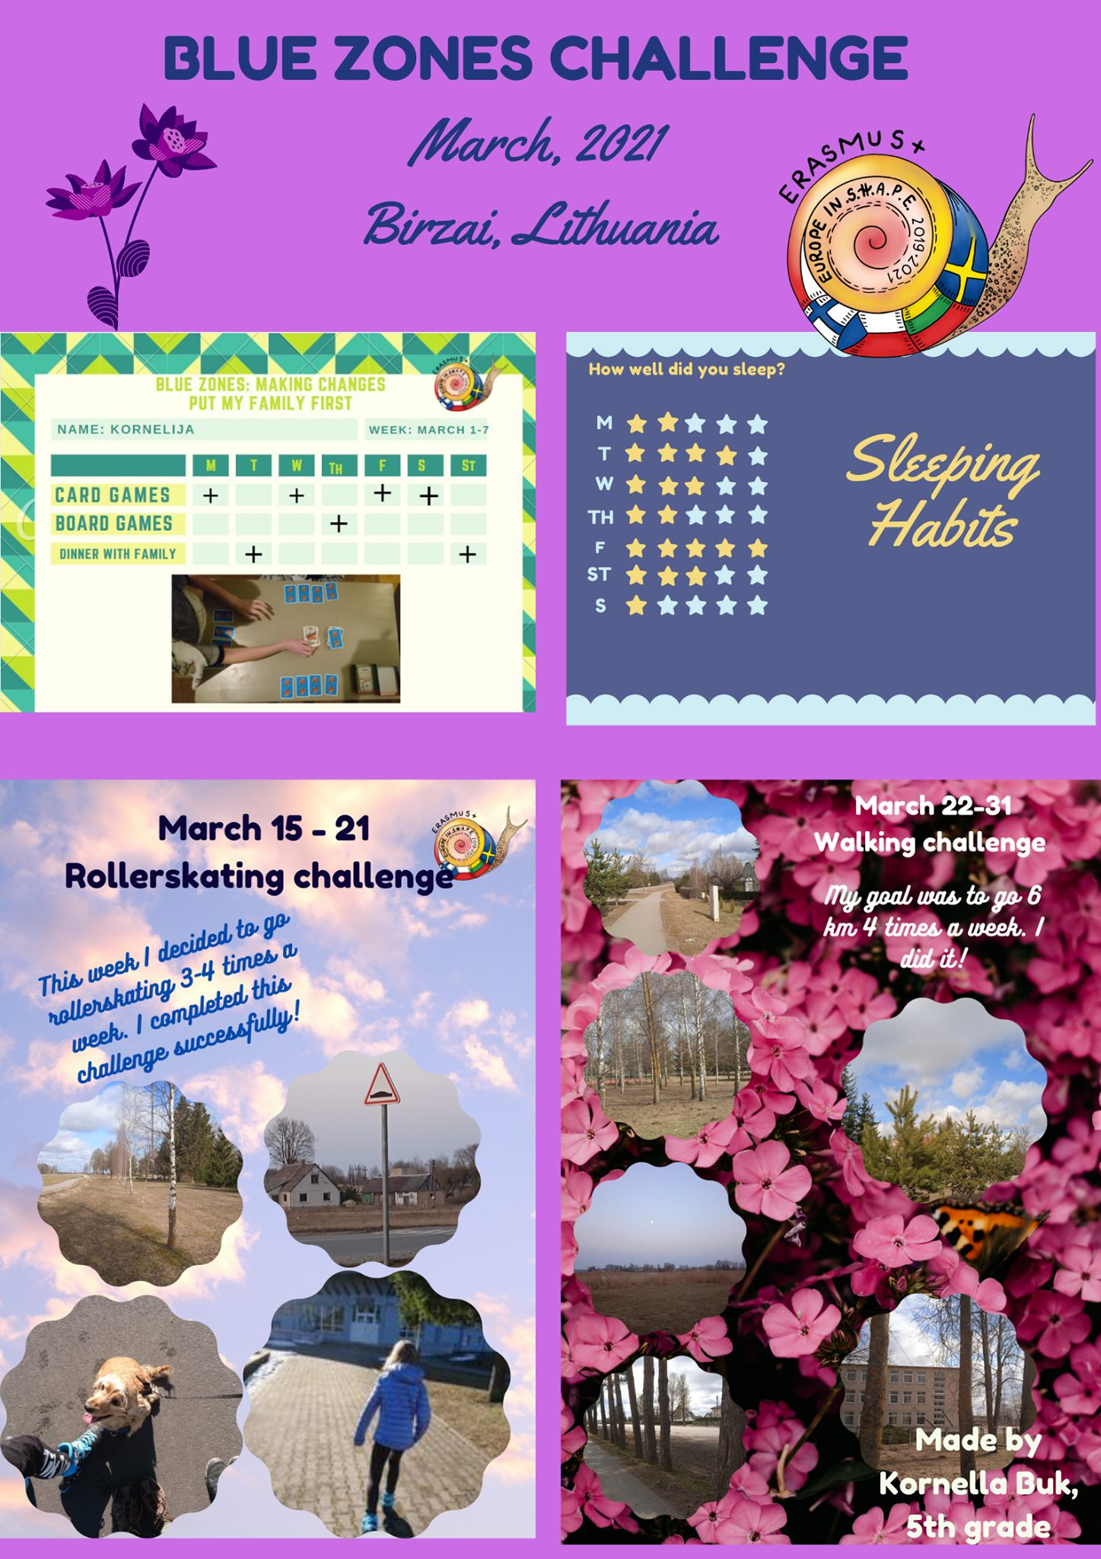

Slide 13



Slide 14
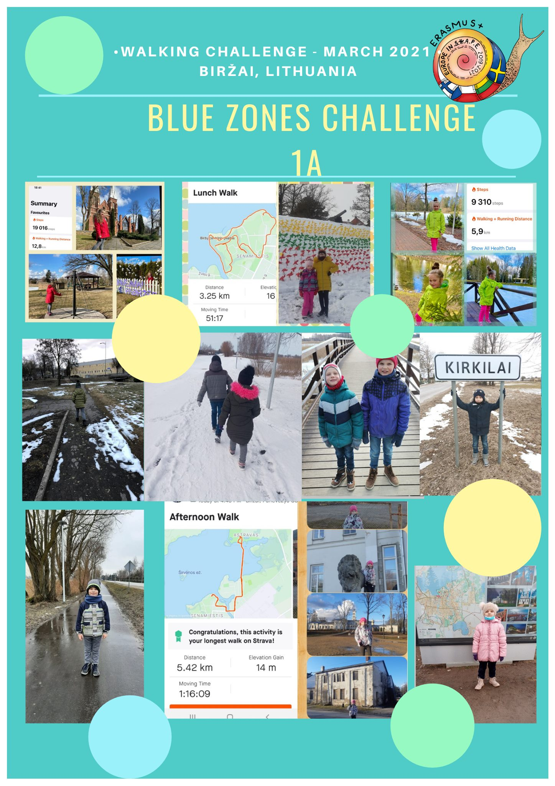


Slide 15
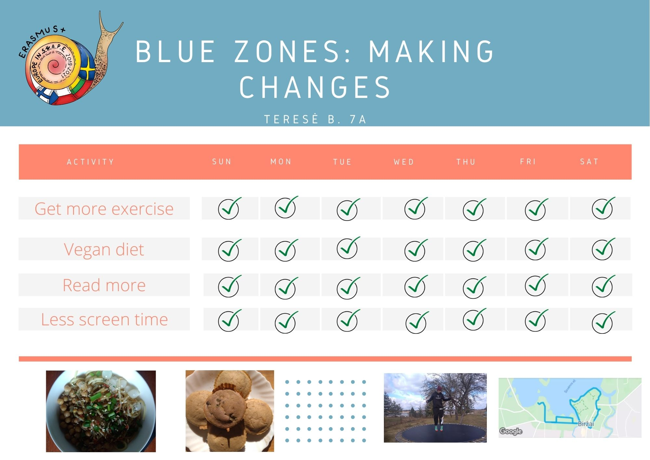
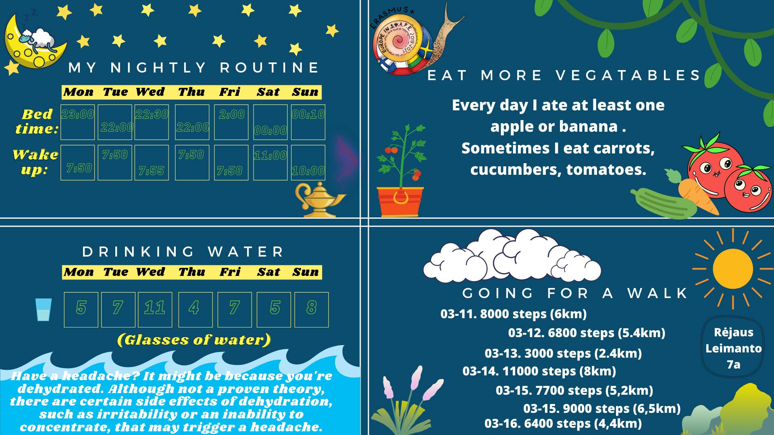

Slide 16
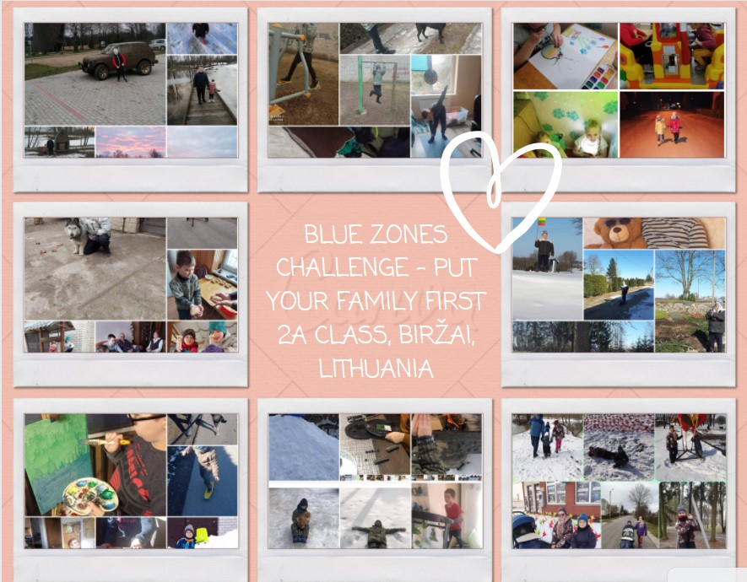
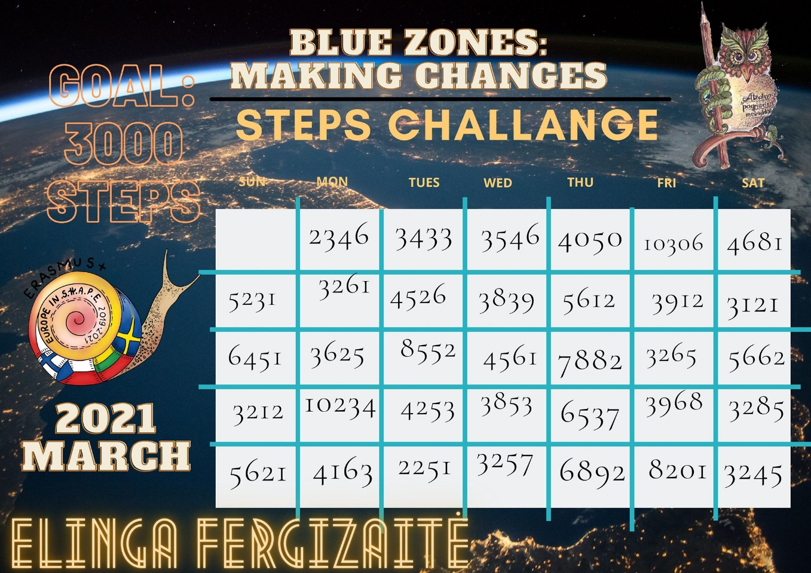

Slide 17

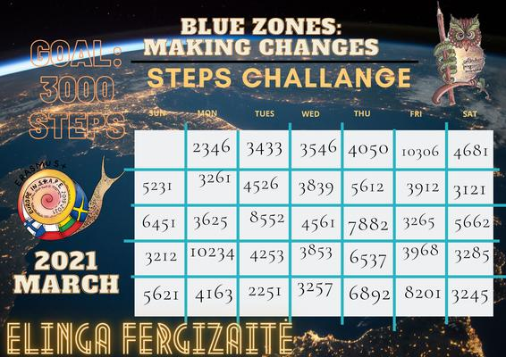

Slide 18

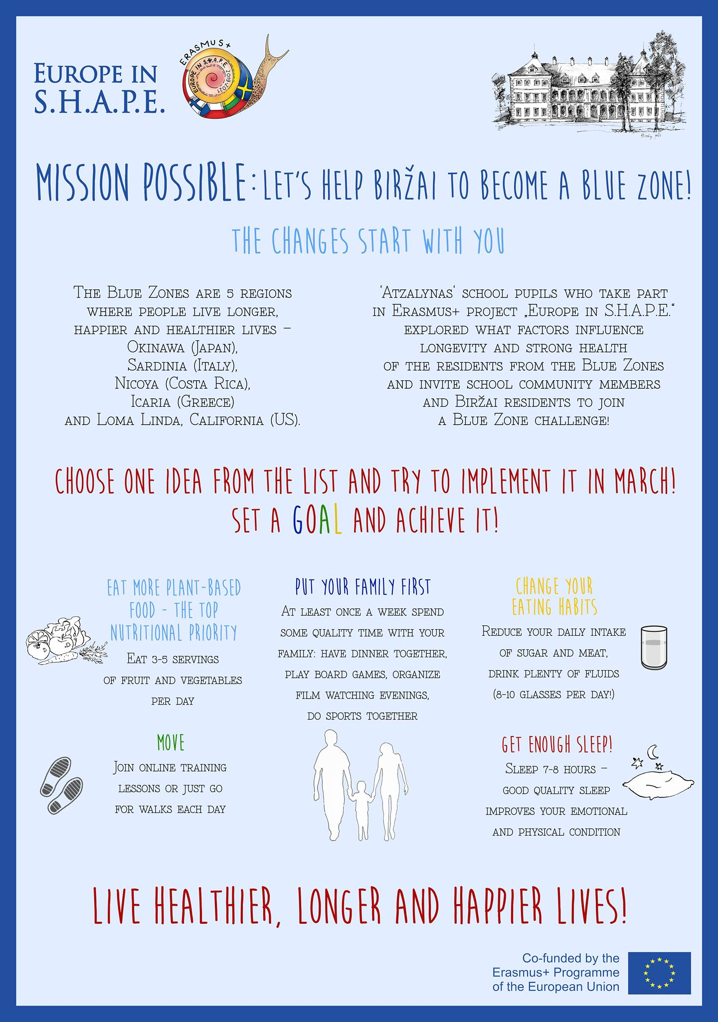

Slide 19
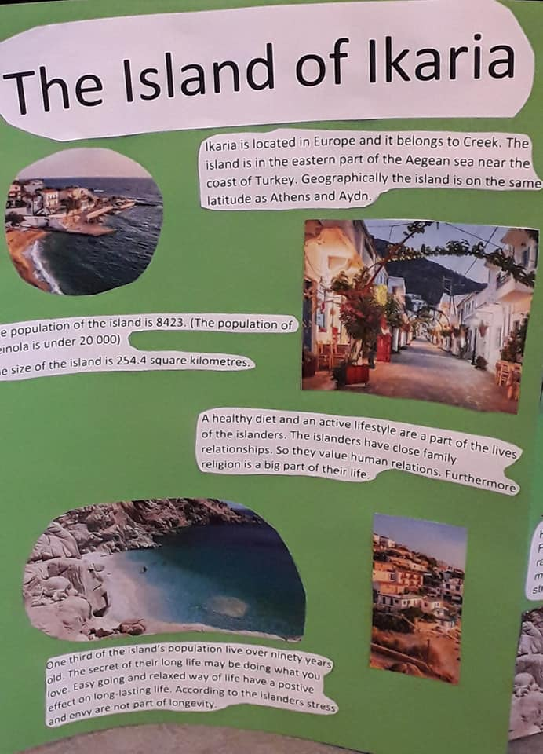
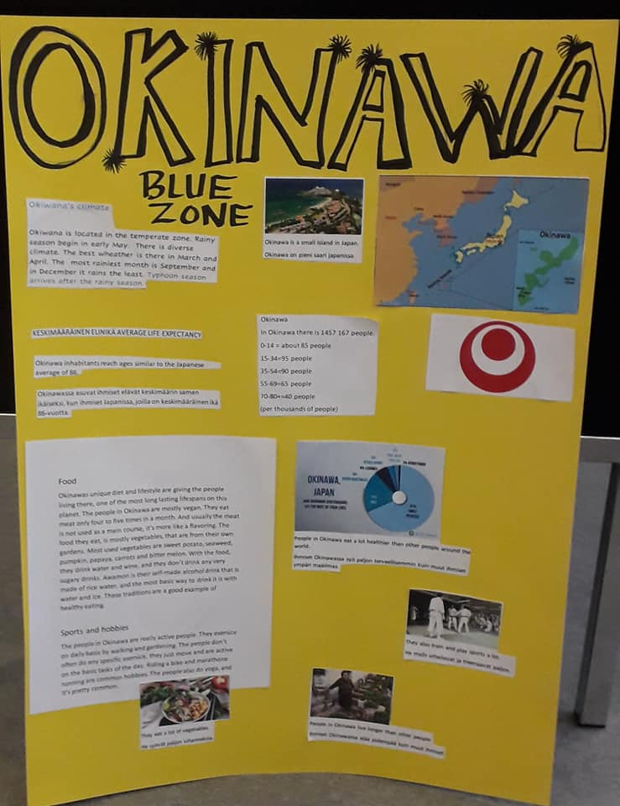

Slide 20
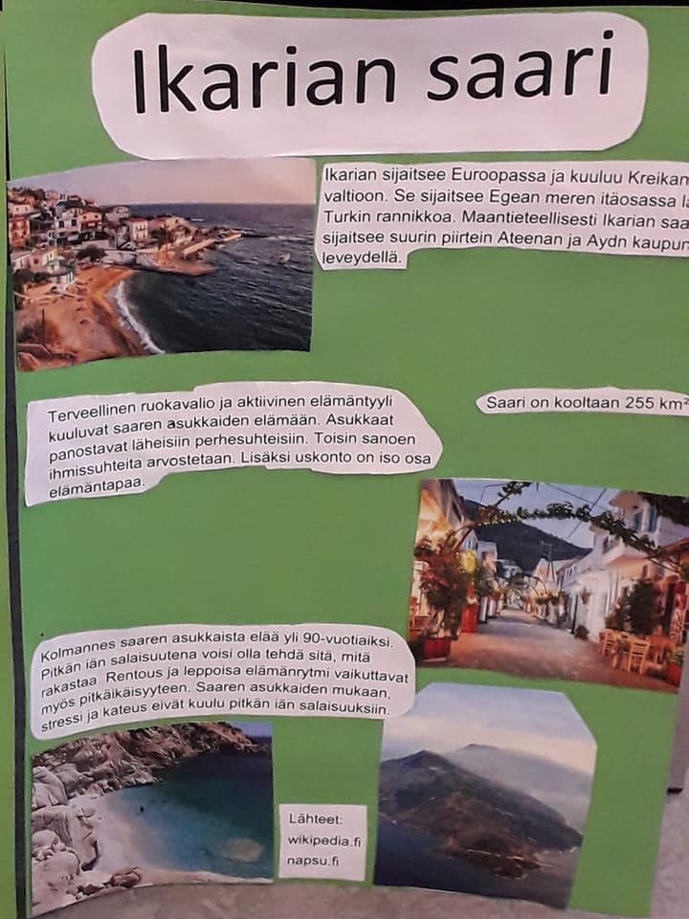


Slide 21
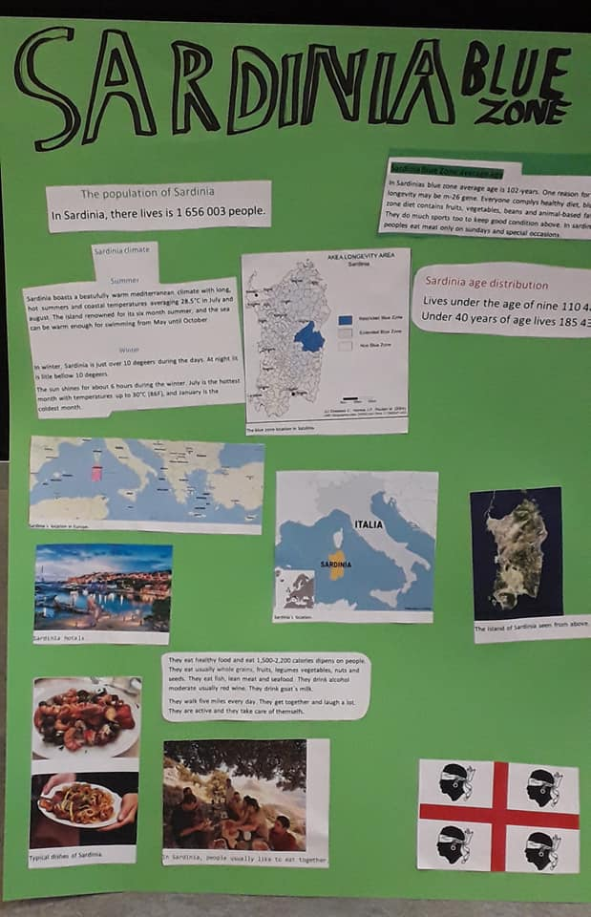
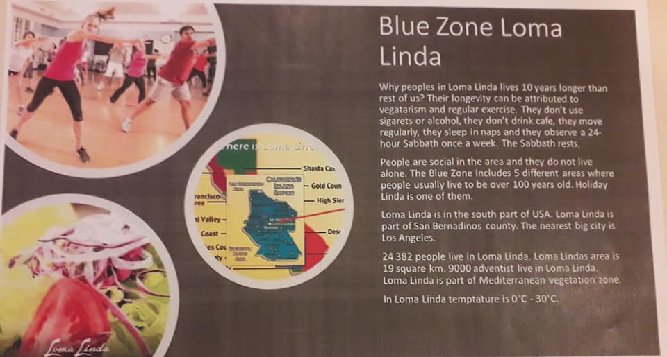

Slide 22
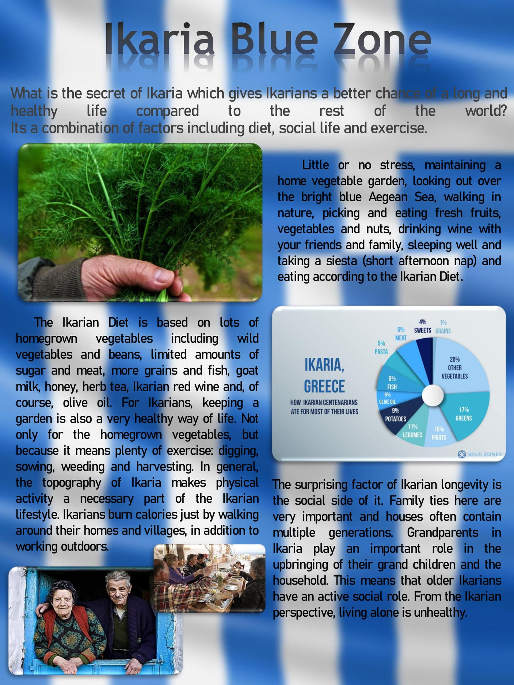
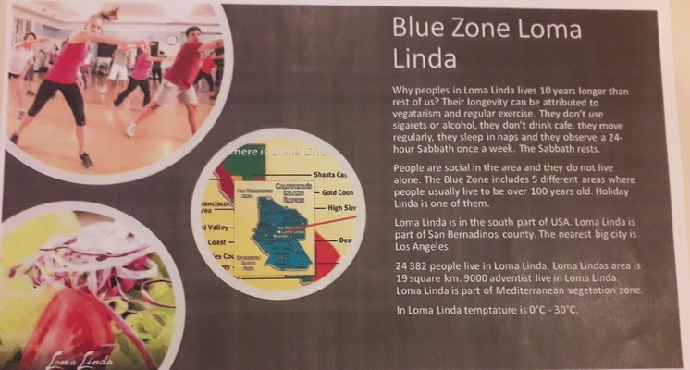

Slide 23
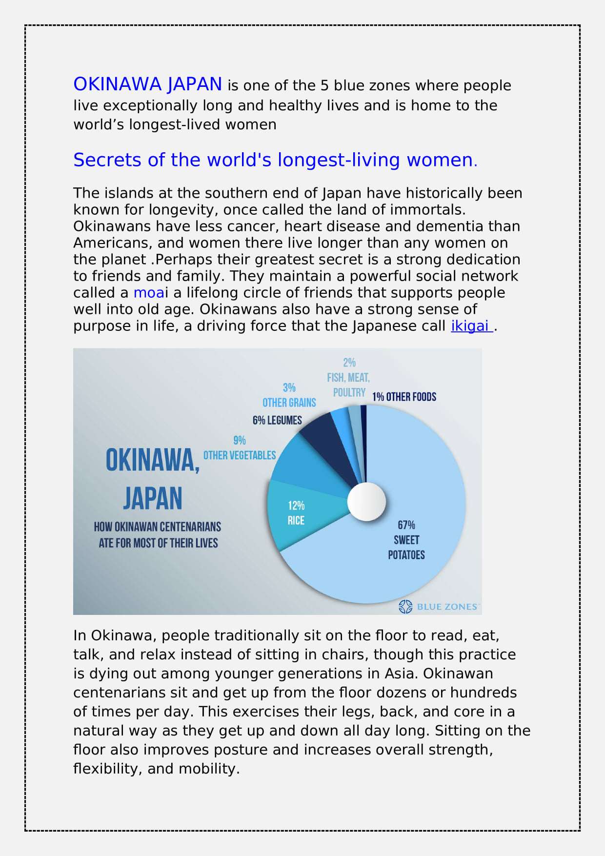


Slide 24
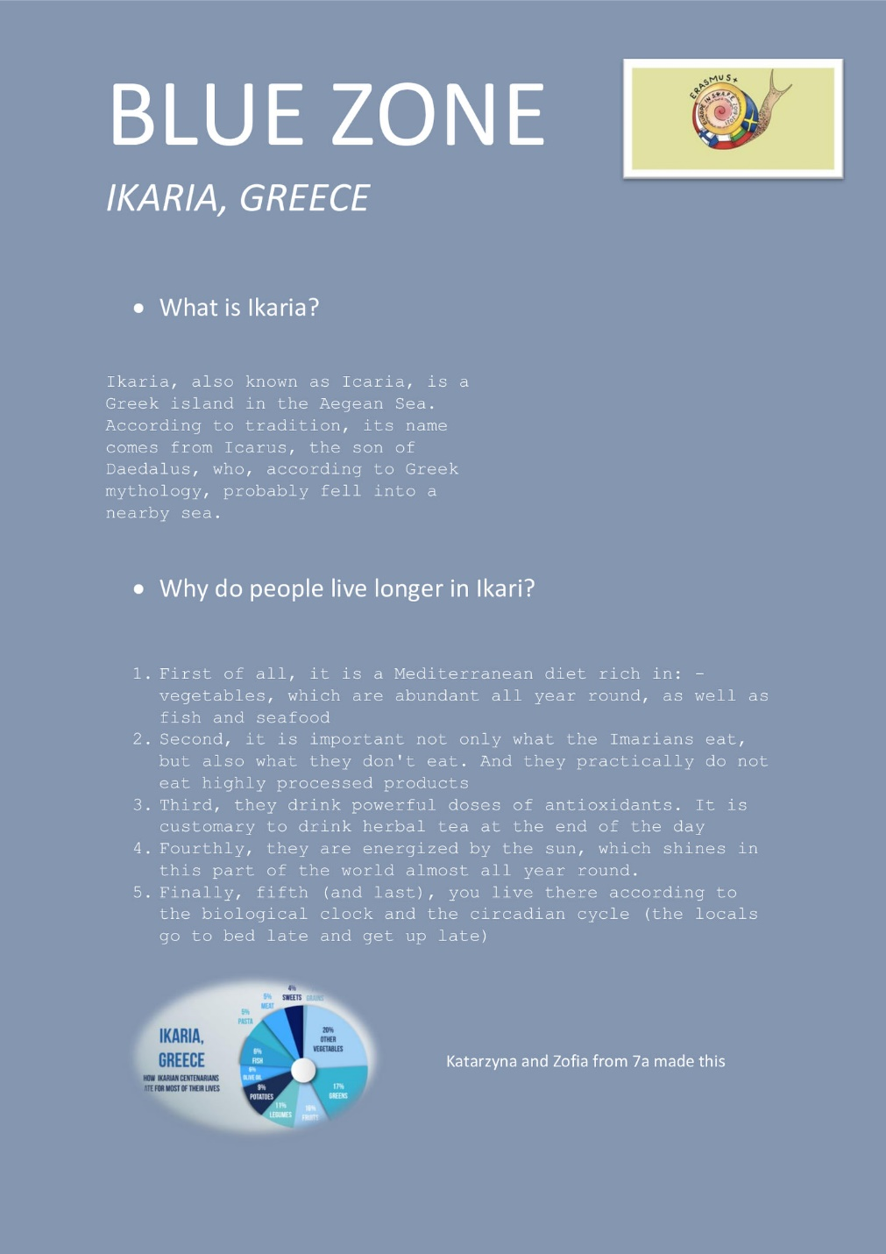


Slide 25
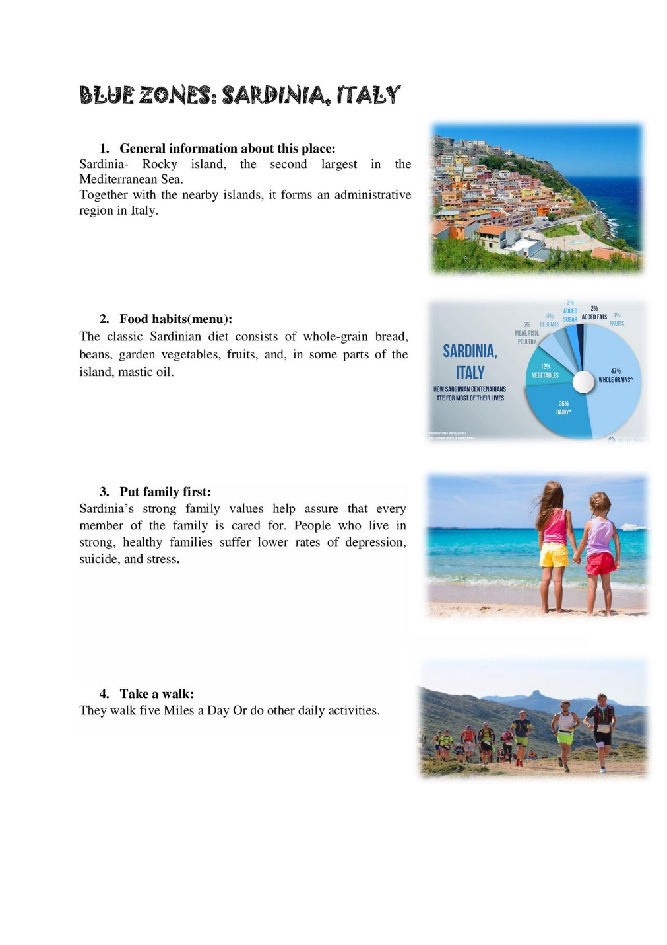
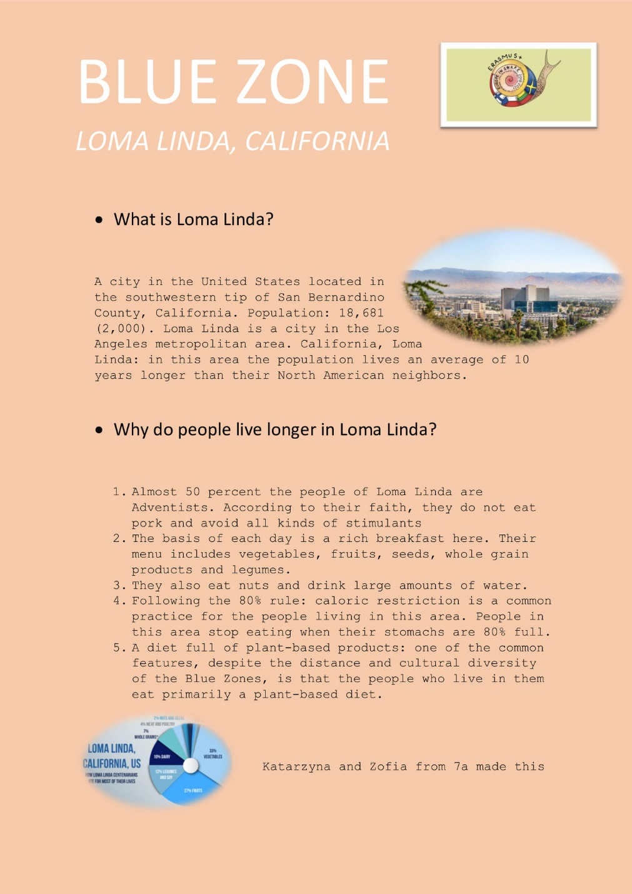

Slide 26
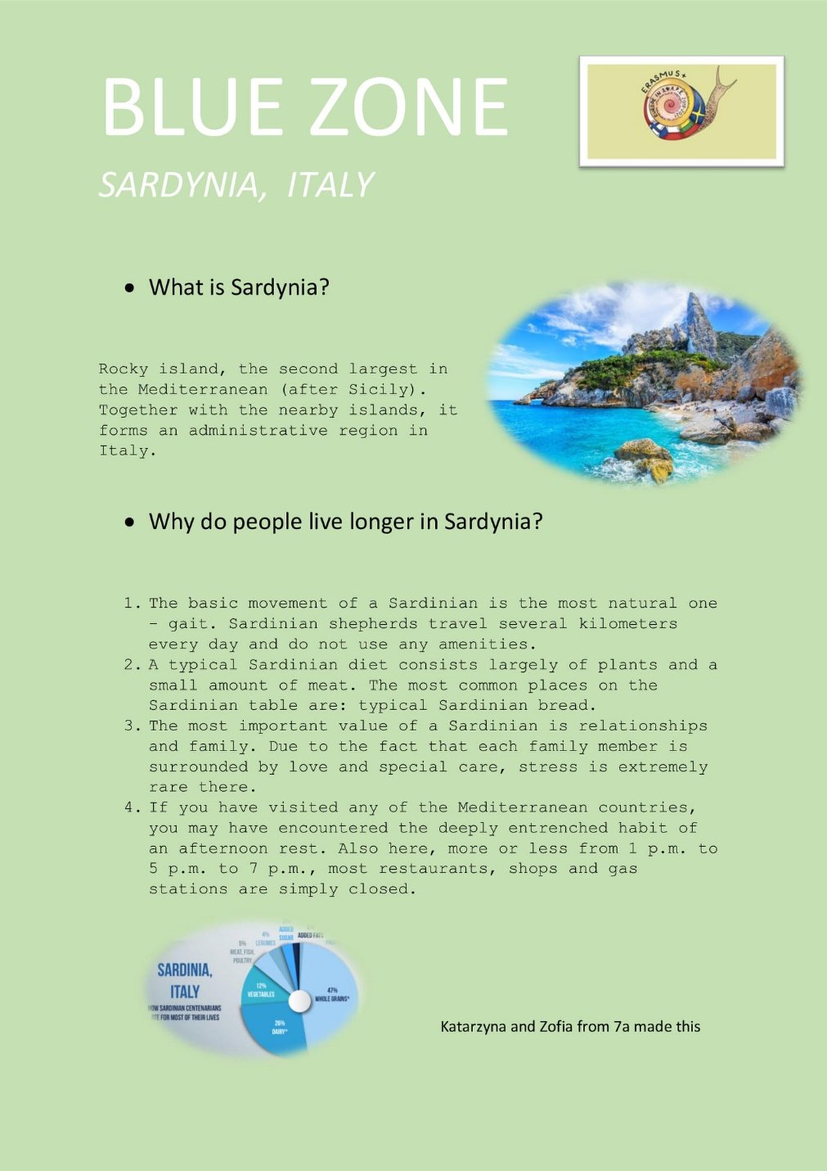
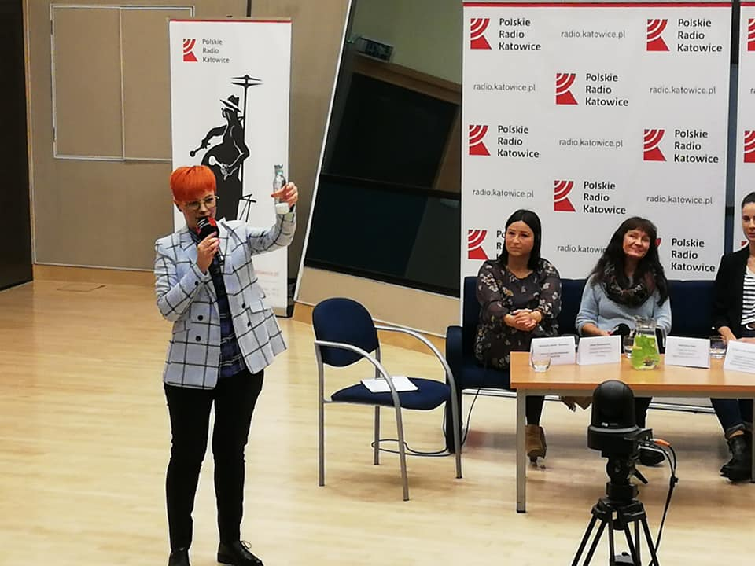

Slide 27
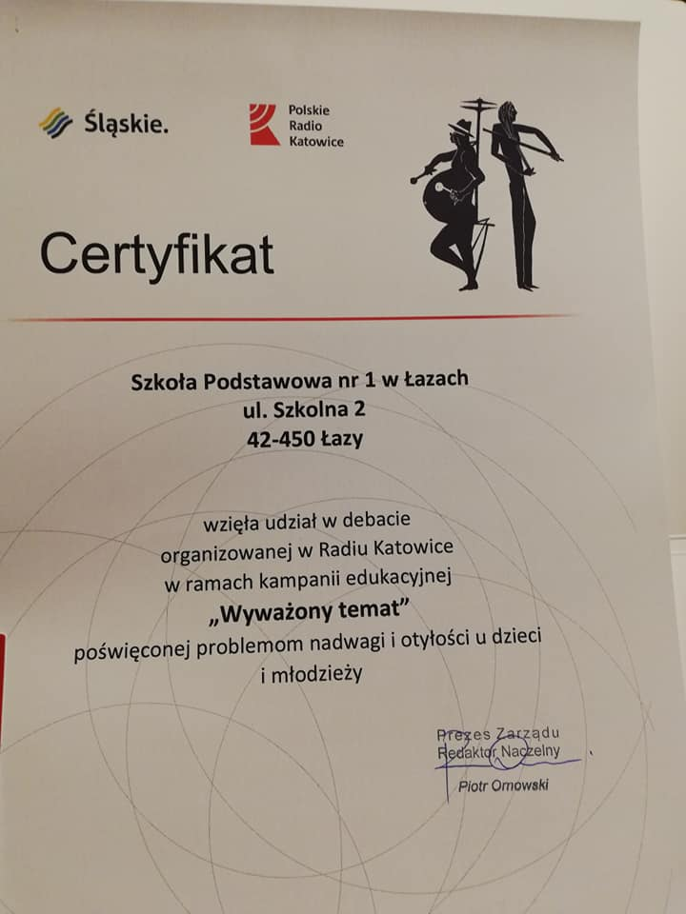

Slide 28
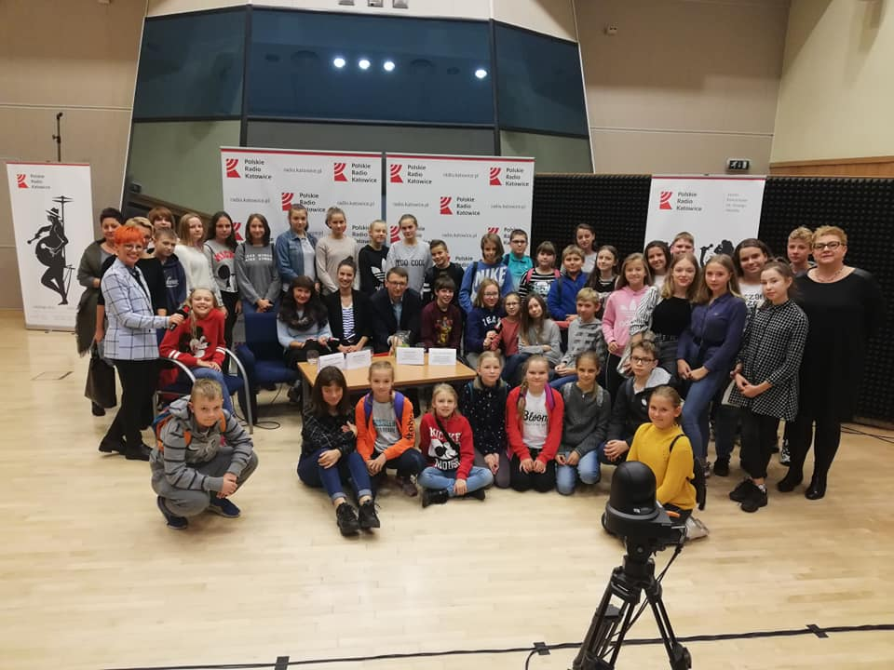
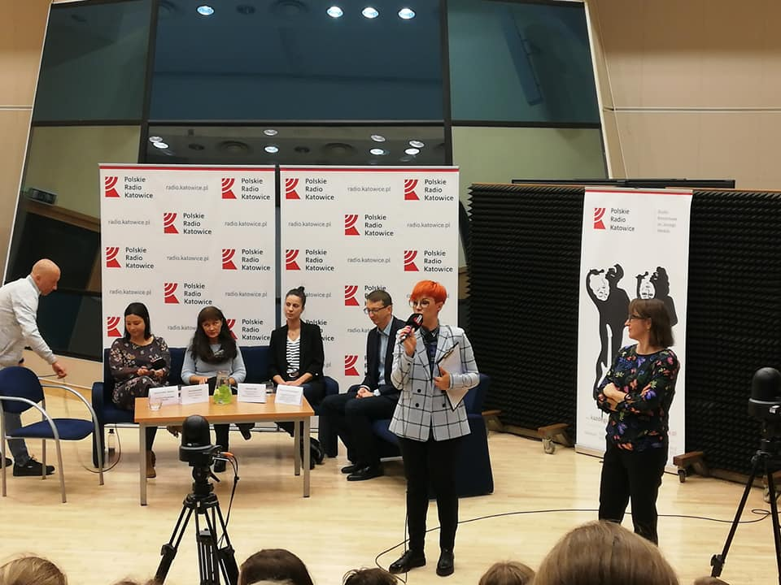

Slide 29
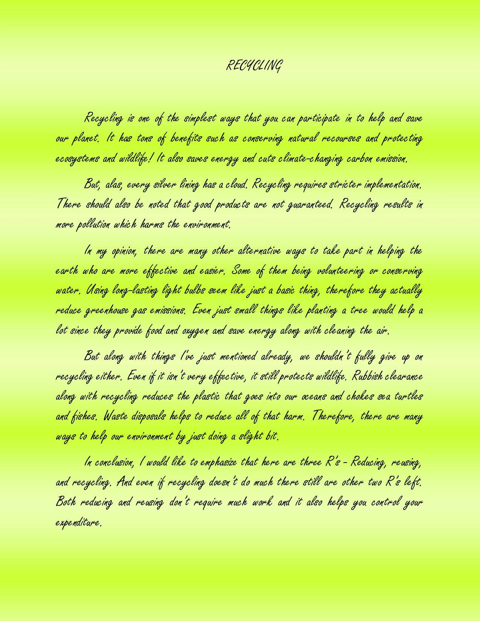
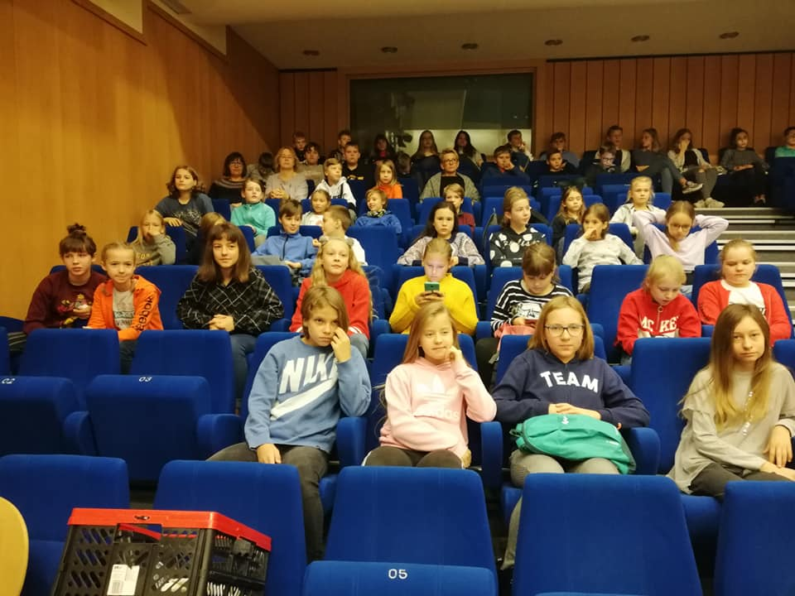

Slide 30
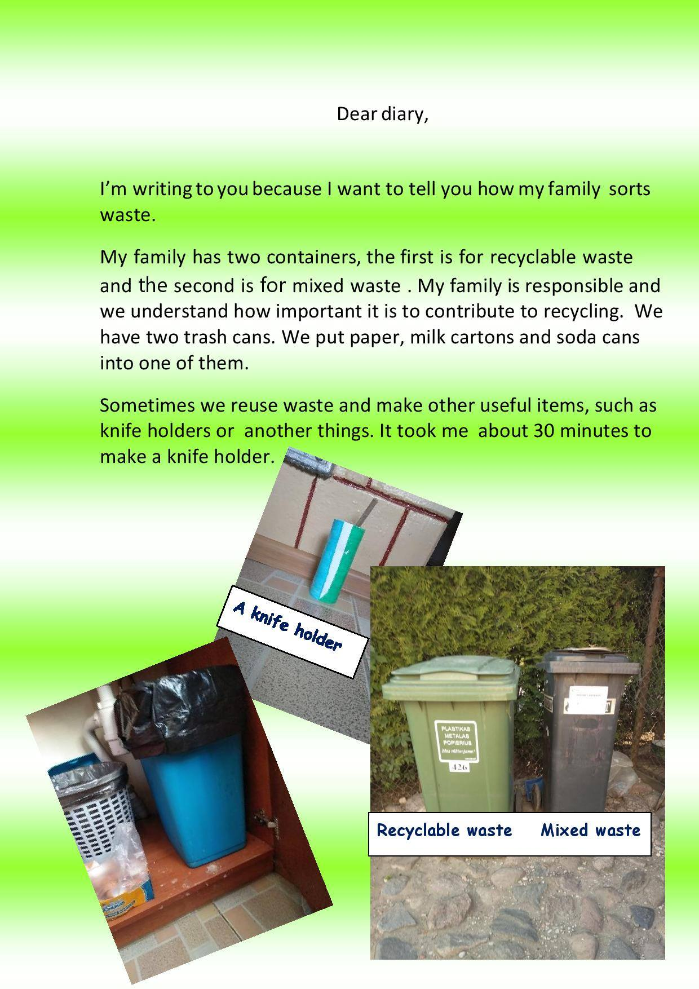
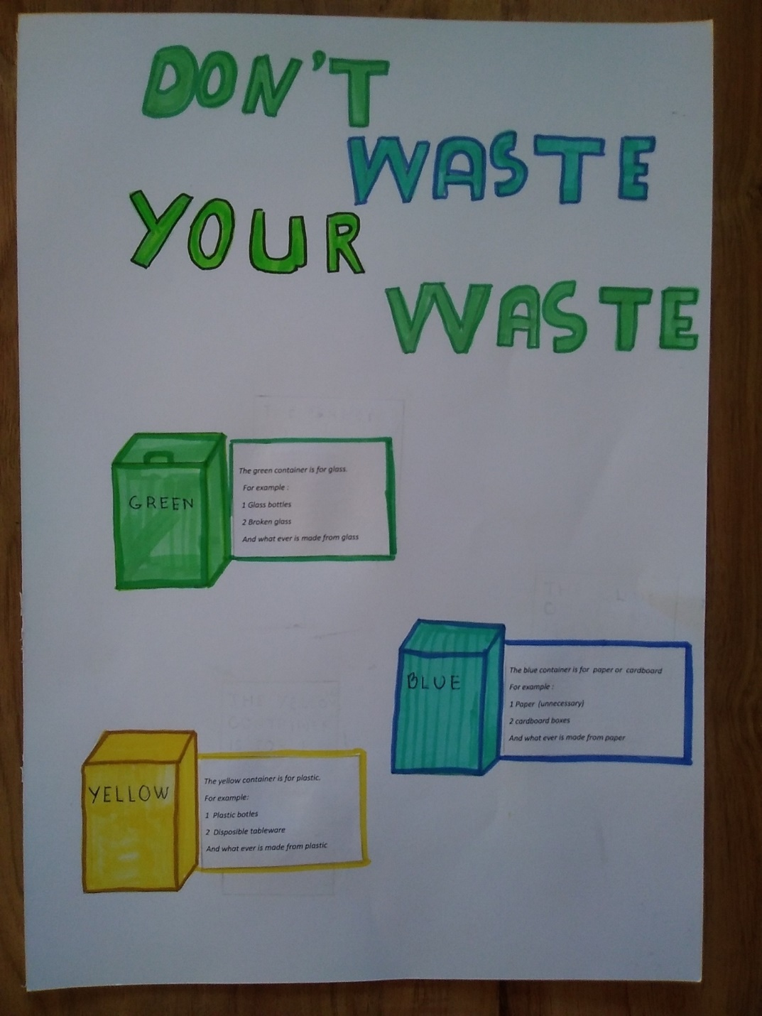

Slide 31
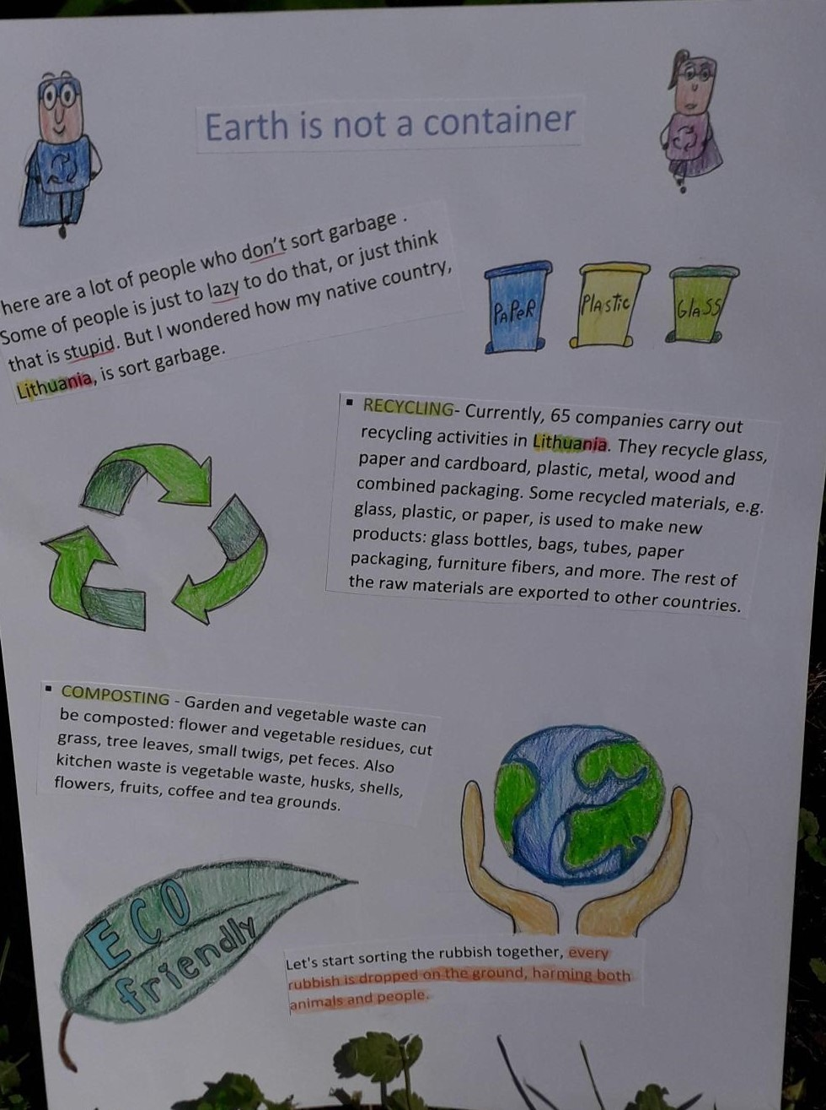
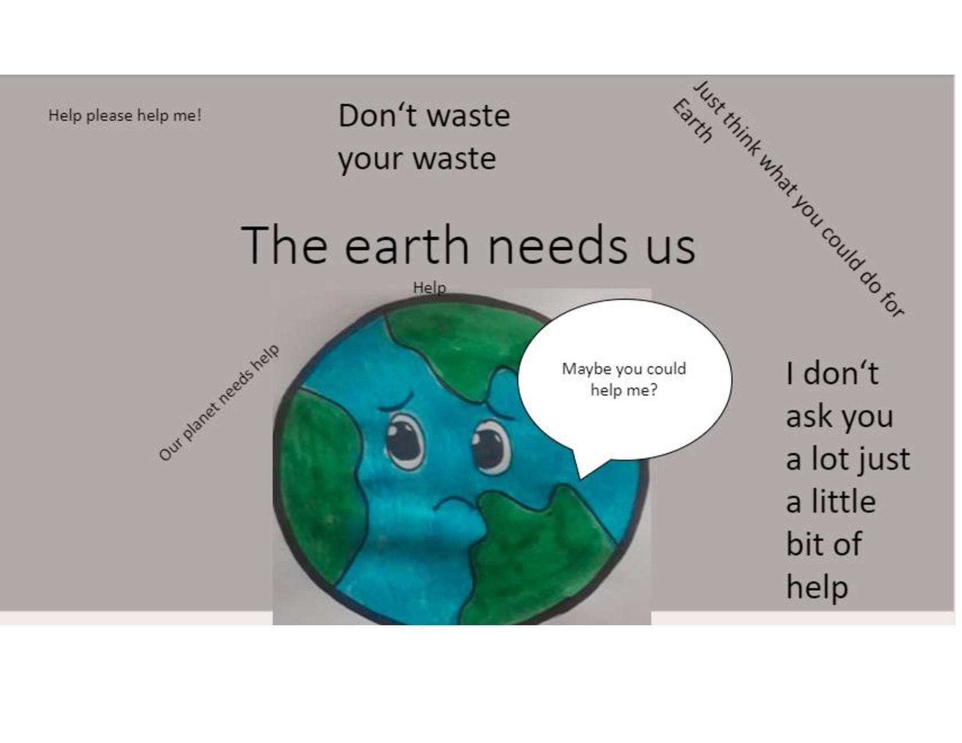

Slide 32

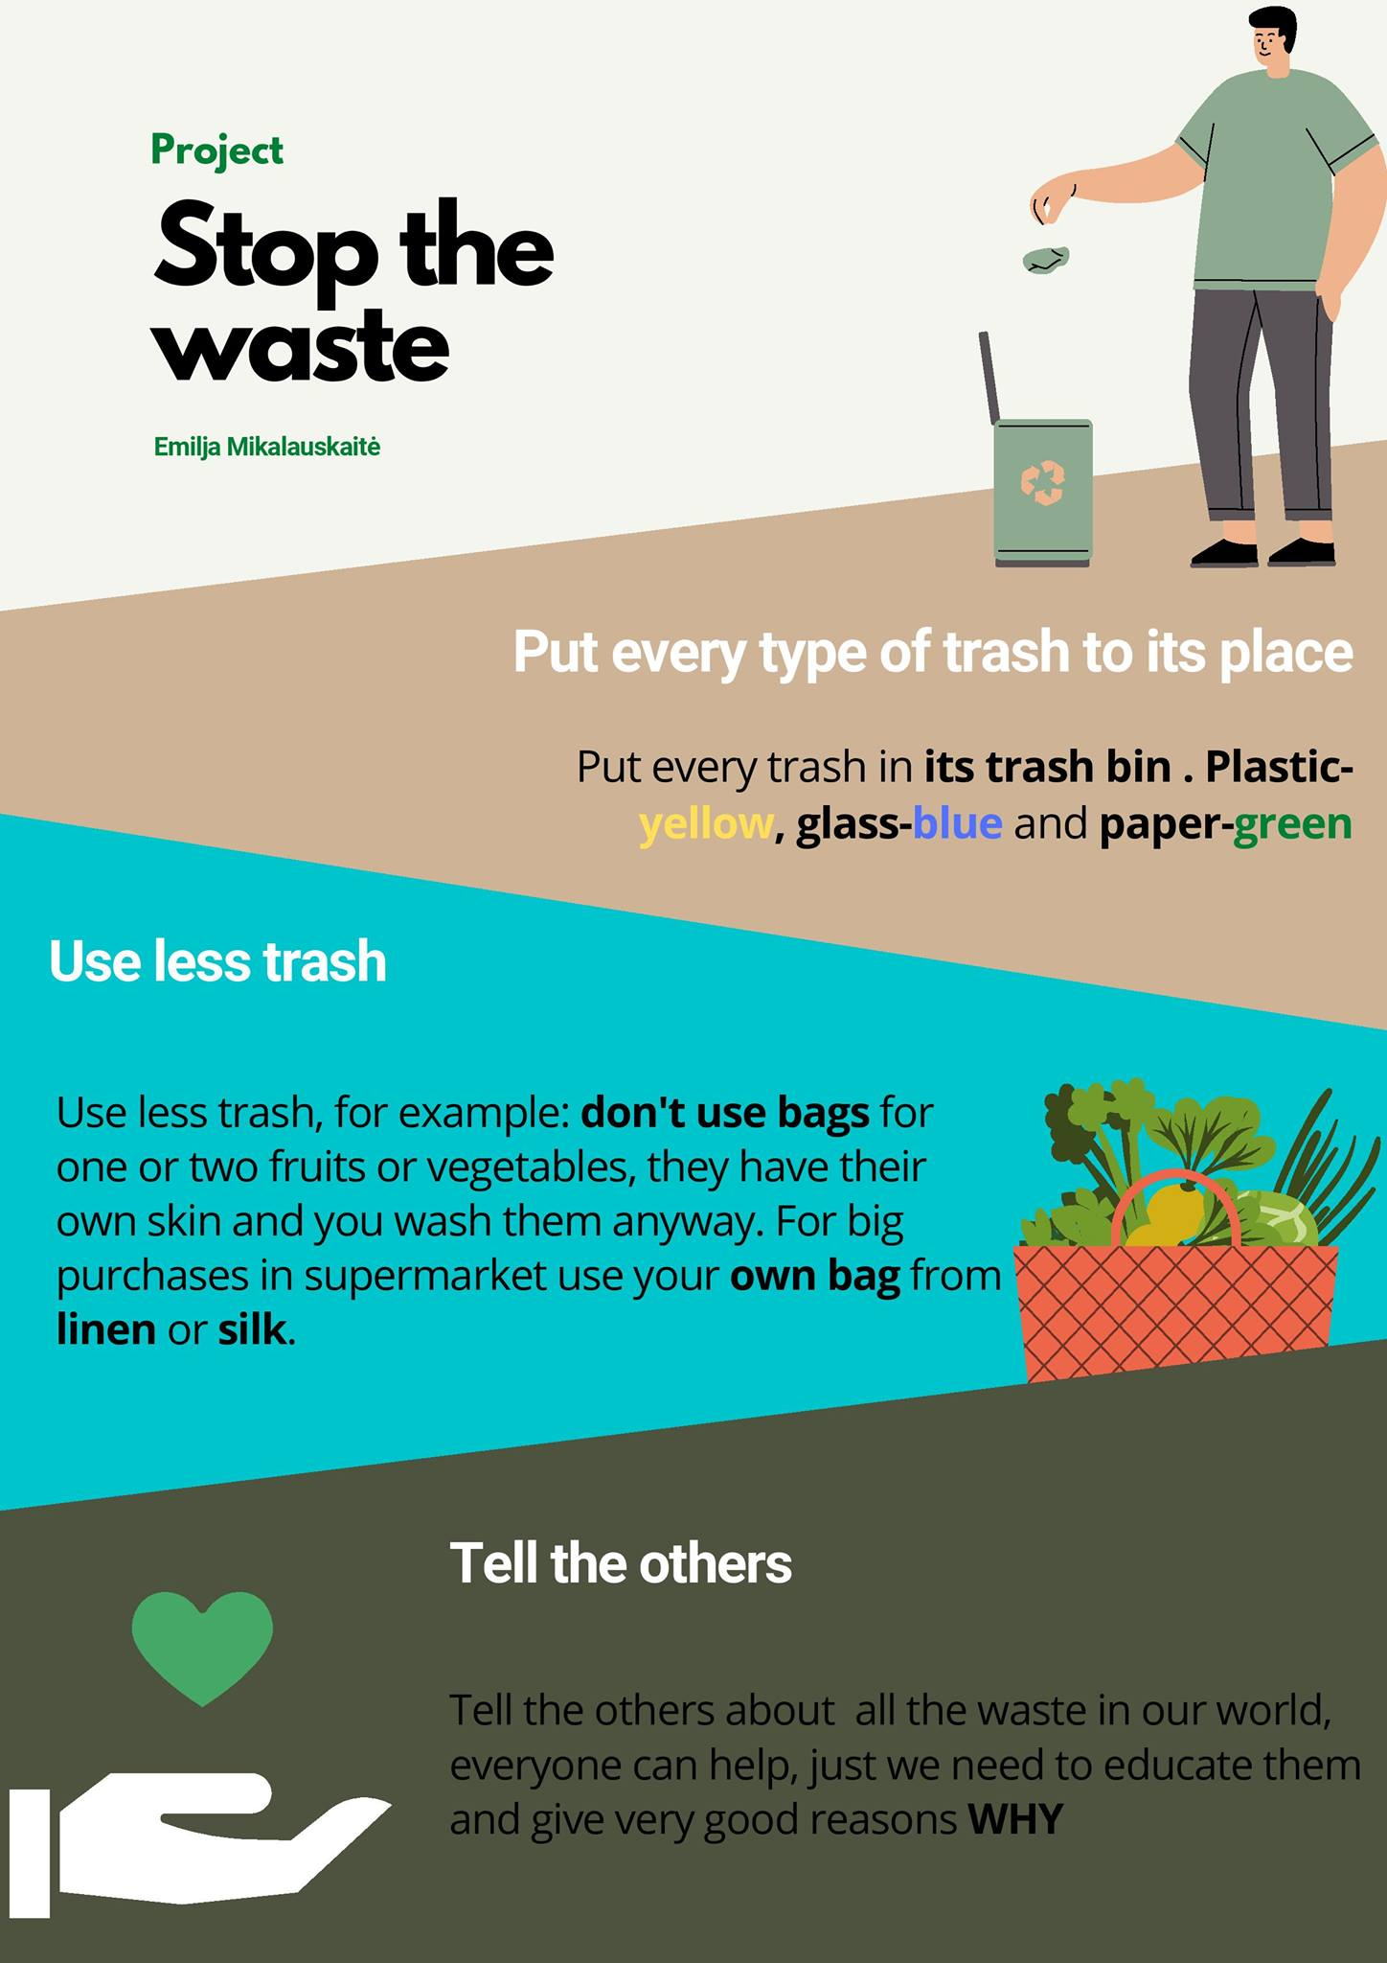

Slide 33
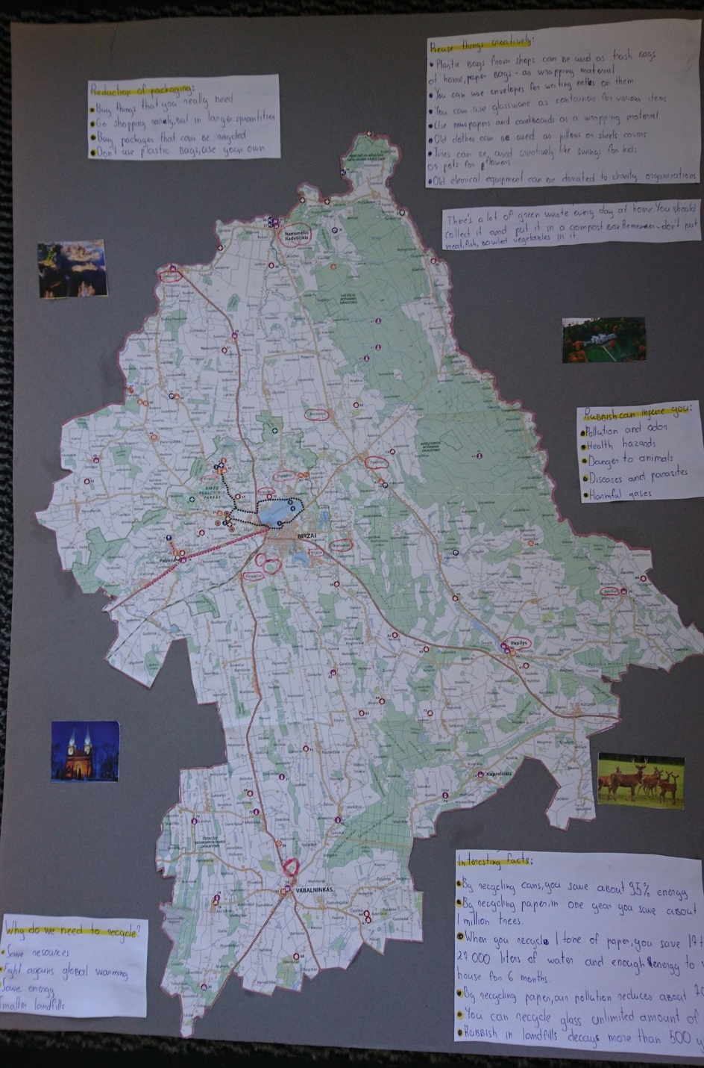
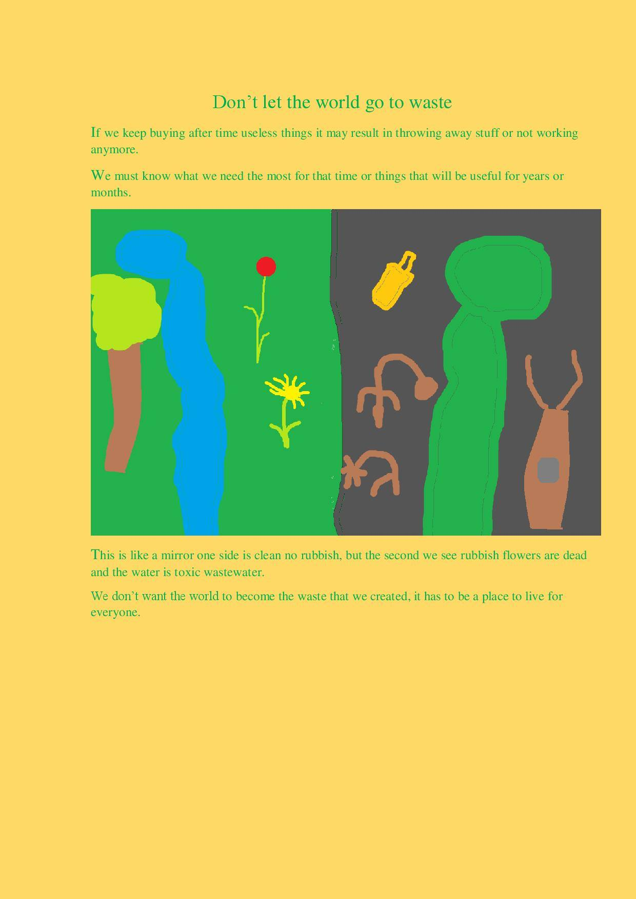

Slide 34

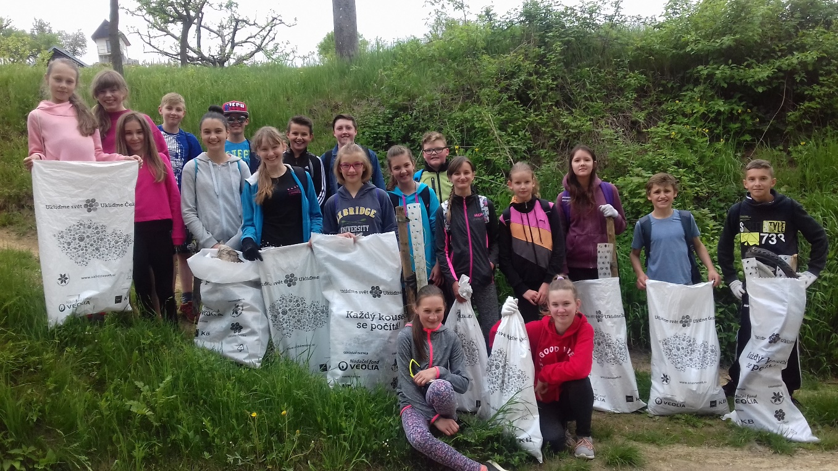

Slide 35
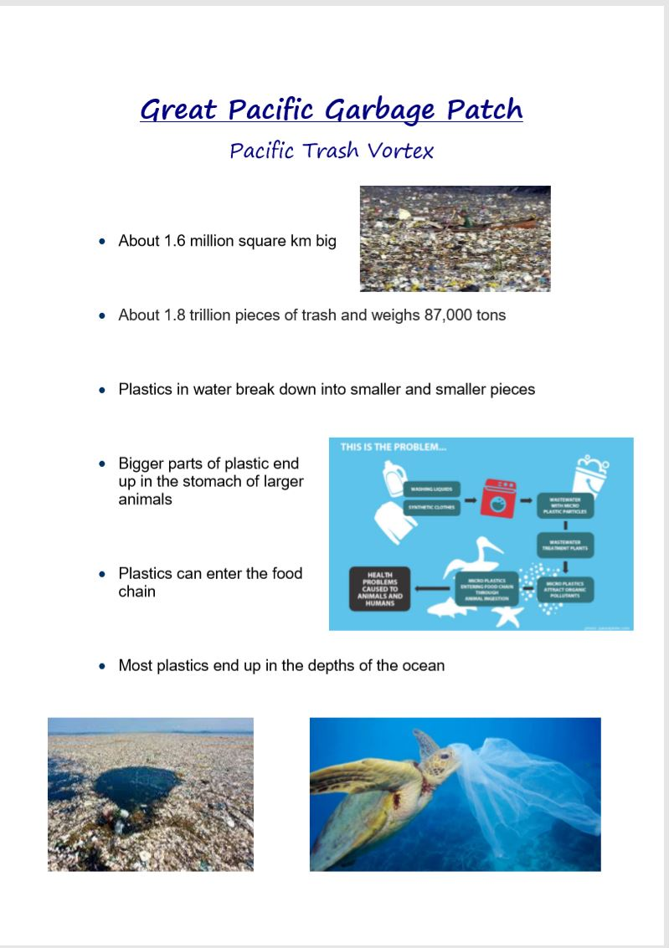
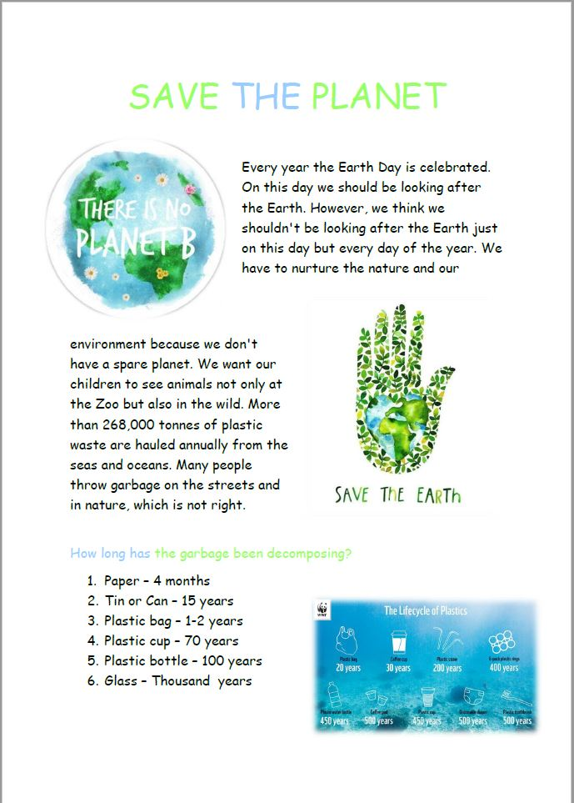

Slide 36



Slide 37



Slide 38



Slide 39



Slide 40



Slide 41



Slide 42



Slide 43



Slide 44



Slide 45



Slide 46



Slide 47



Slide 48



Slide 49



Slide 50



Slide 51



Slide 52


Slide 53
The European Commission's support for the production of this publication does not constitute an endorsement of the contents, which reflect the views only of the authors, and the Commission cannot be held responsible for any use which may be made of the information contained therein.

